Slide 1
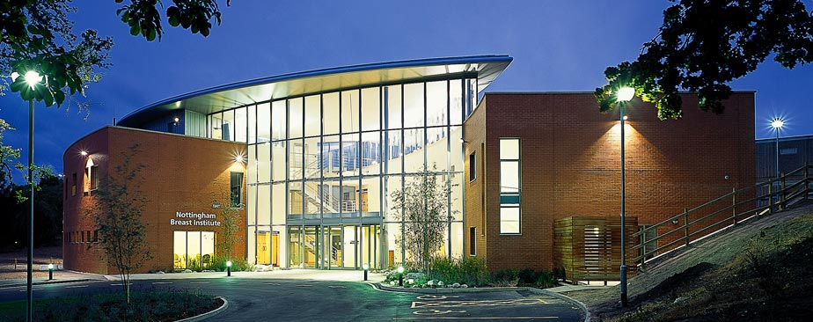
The importance of specialist breast surgery in optimising outcomes for breast cancer patients
Kristjan S. Asgeirsson
Consultant Oncoplastic Breast Surgeon
Nottingham Breast Institute/Nordic Breast Institute

Slide 2
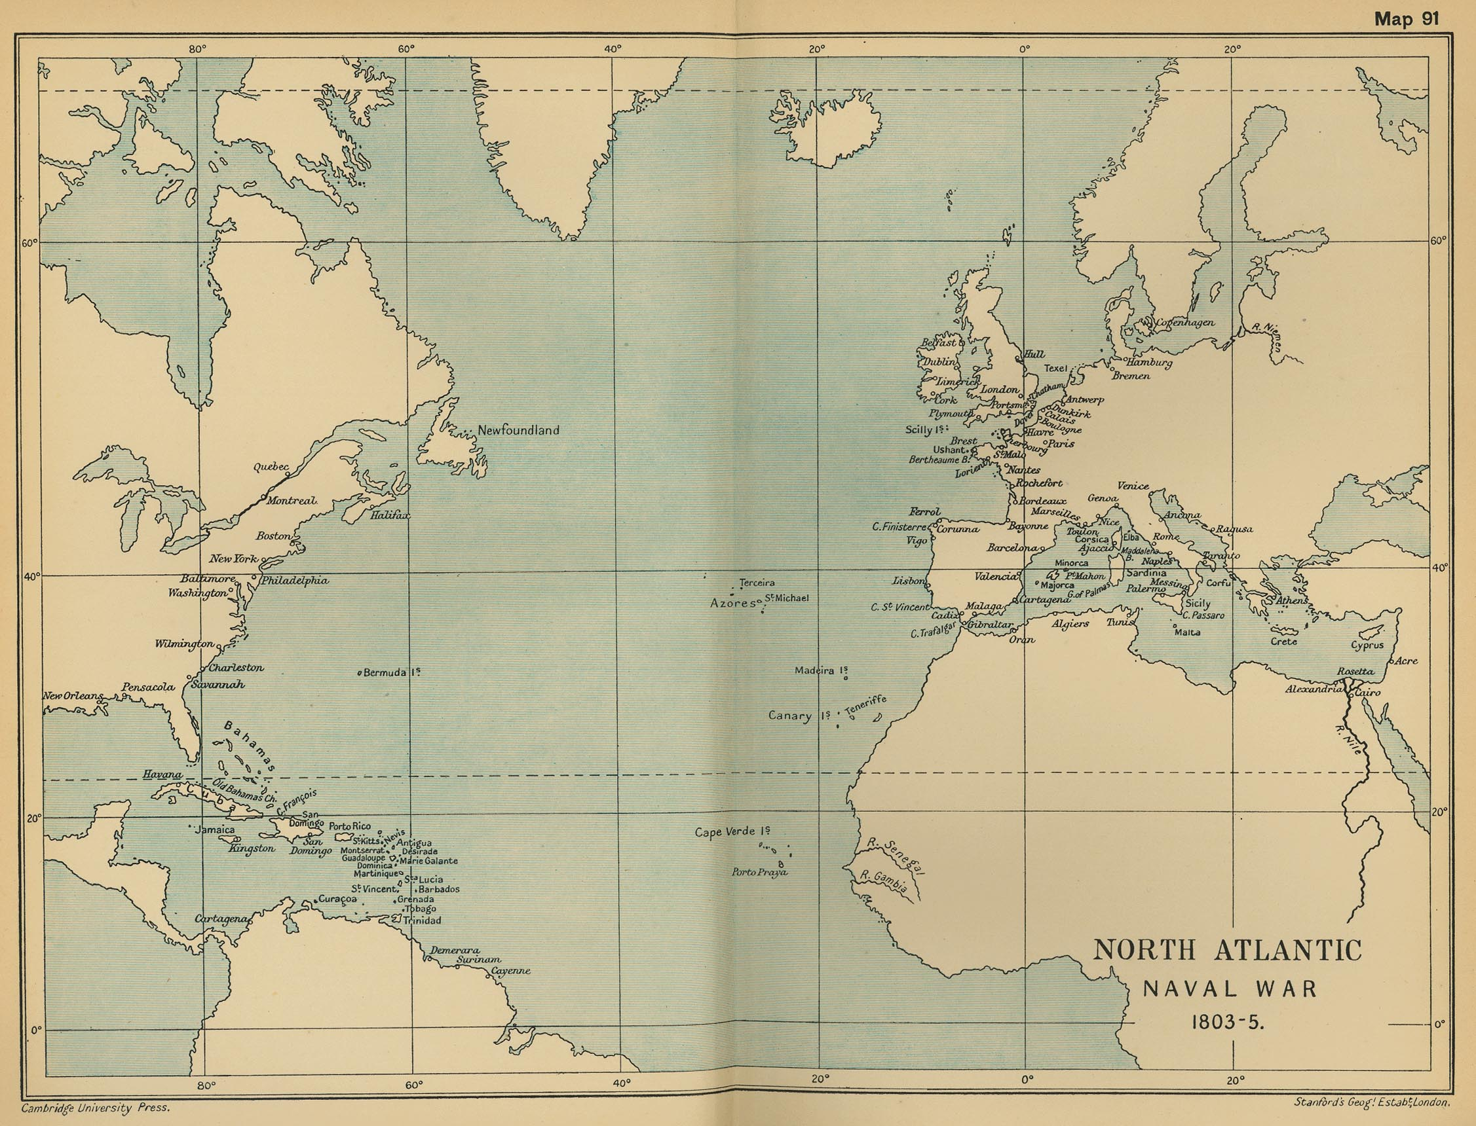

Slide 3
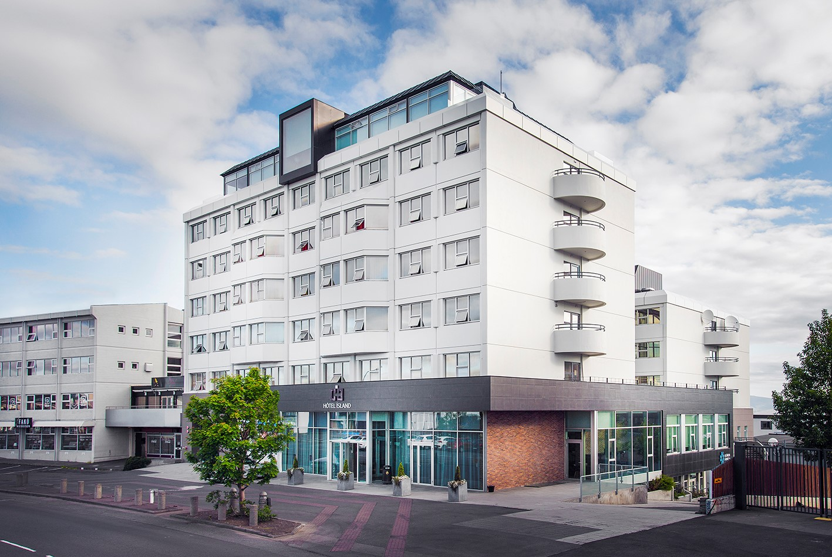

The Nottingham Breast Institute

Slide 4
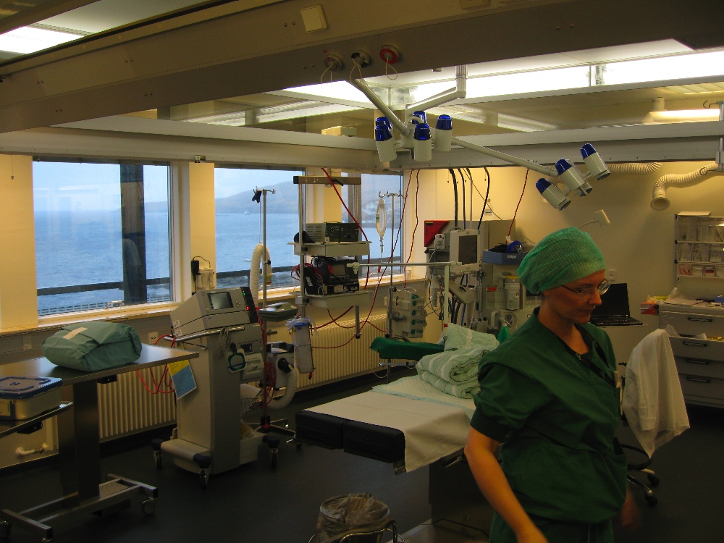
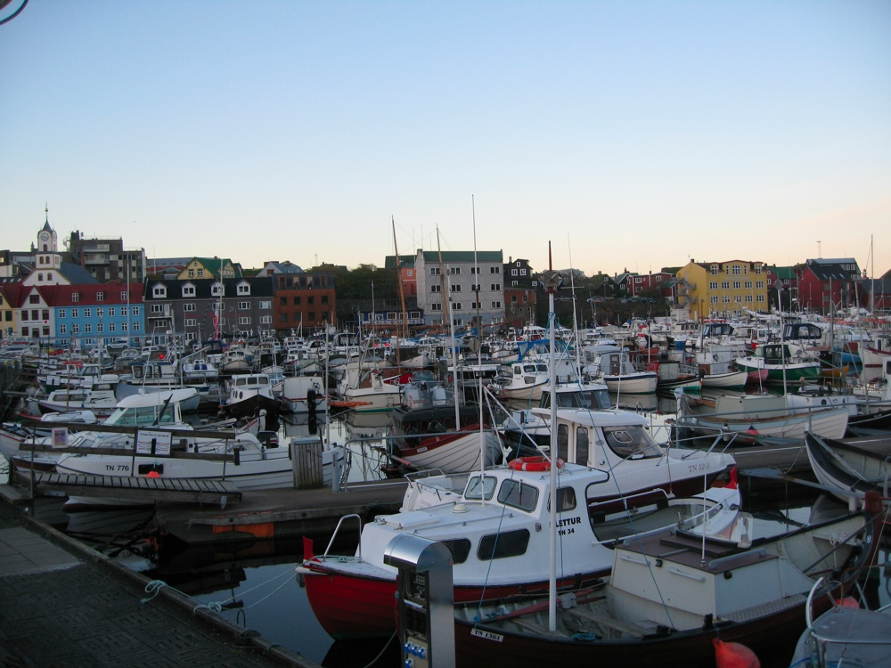

Slide 5
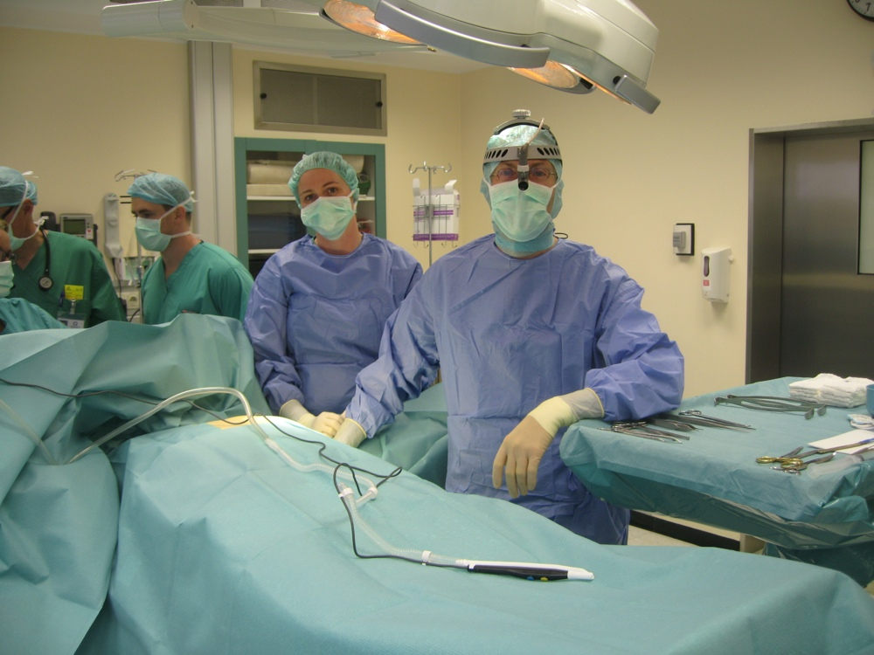
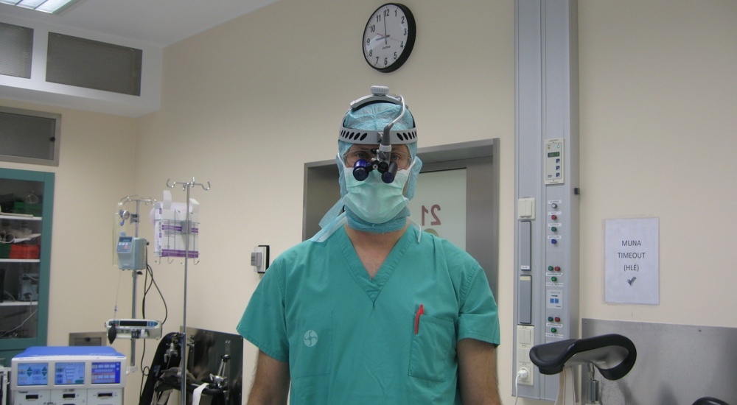
I am an oncoplastic breast surgeon

Slide 6
Onco

Slide 7
Onco - Plastic

Slide 8
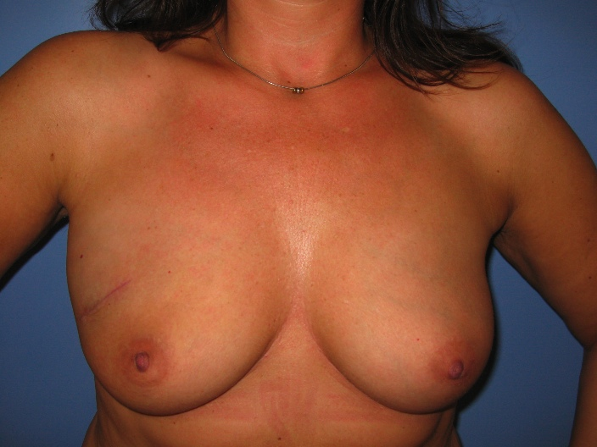
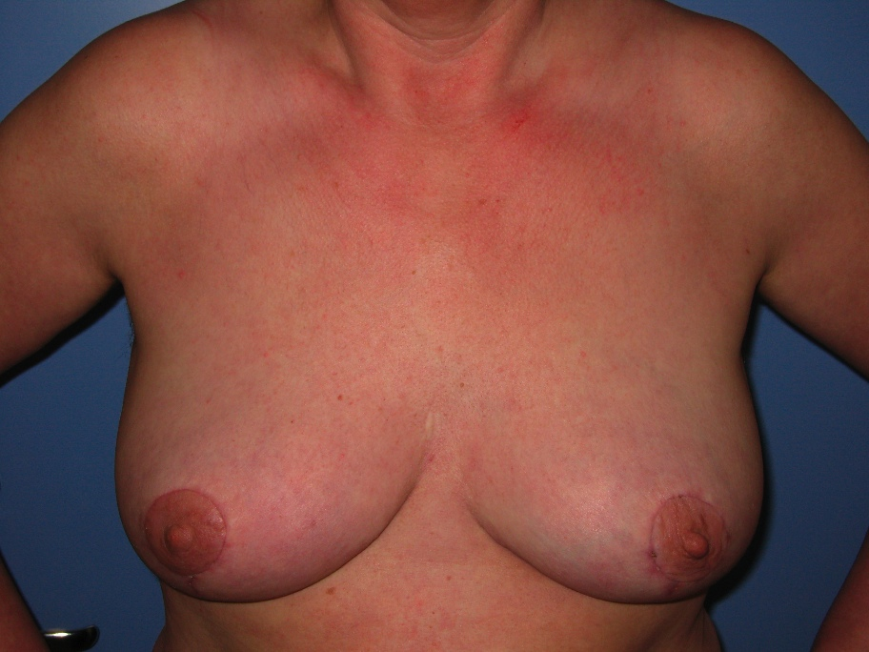
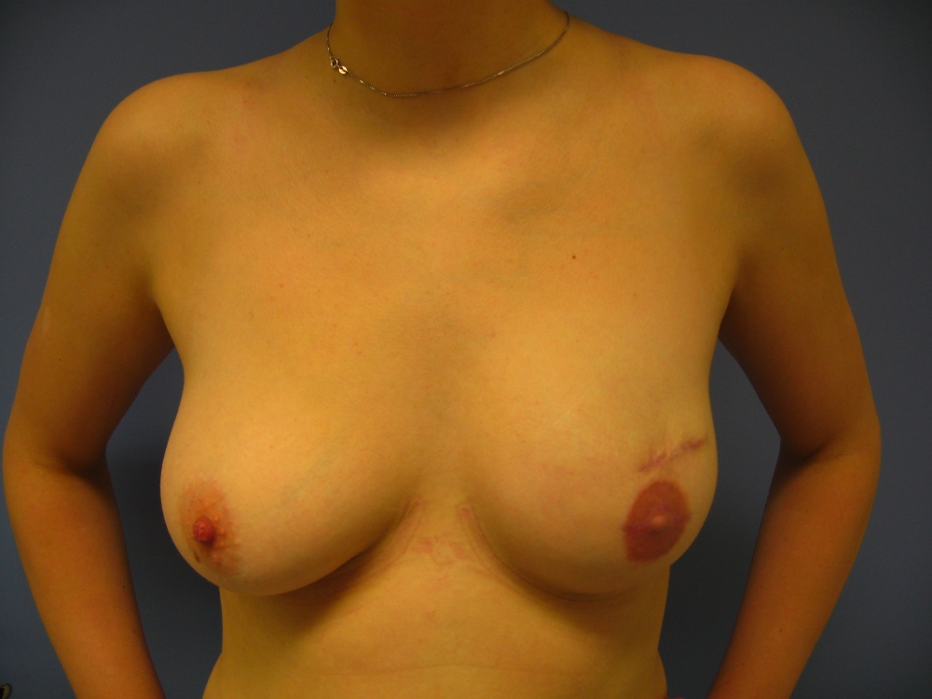
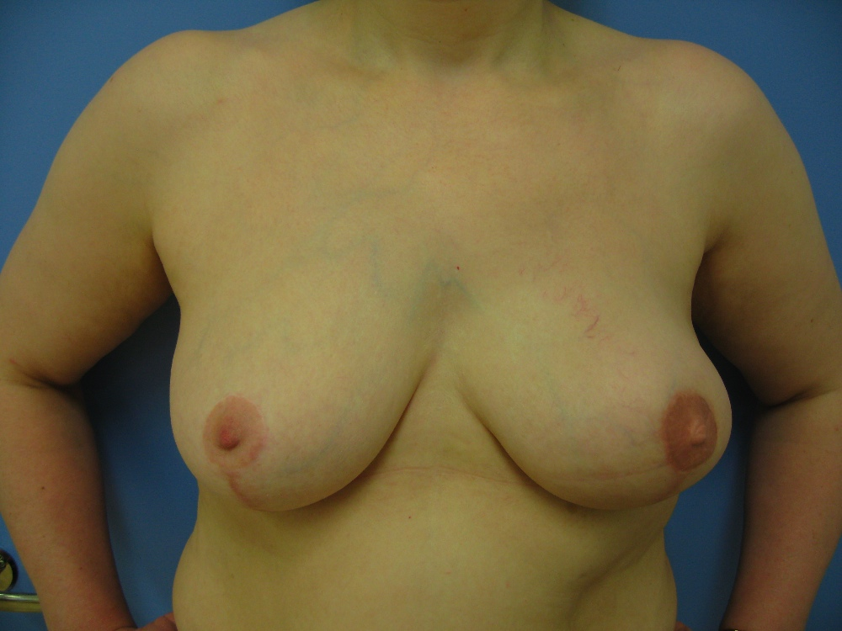
Oncoplastic breast surgery
Breast conservation
Immediate total breast
reconstruction
Therapeutic
Mammoplasty
(Volume displacement)
LD-miniflap
(Volume replacement)
Implants
Flaps
Notes:
So the concept of oncoplastic breast surgery was used for techniques that improve outcomes in breast conservation with volume replacement or volume displacement and immediate total breast reconstruction.
More recently the term has been expanded to incorporate techniques to improve outcomes of traditional breast cancer surgery, risk reducing surgery and delayed total breast reconstruction

Slide 9
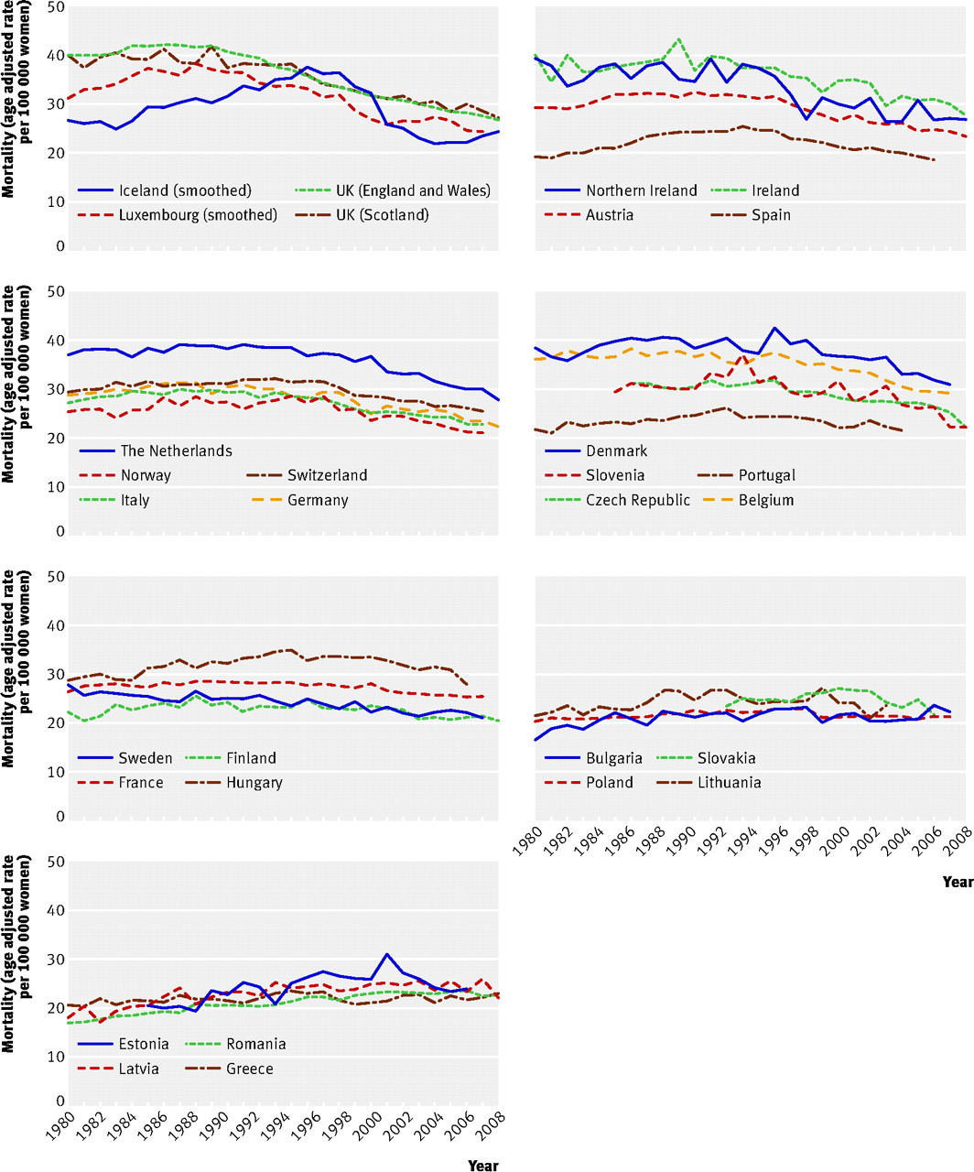
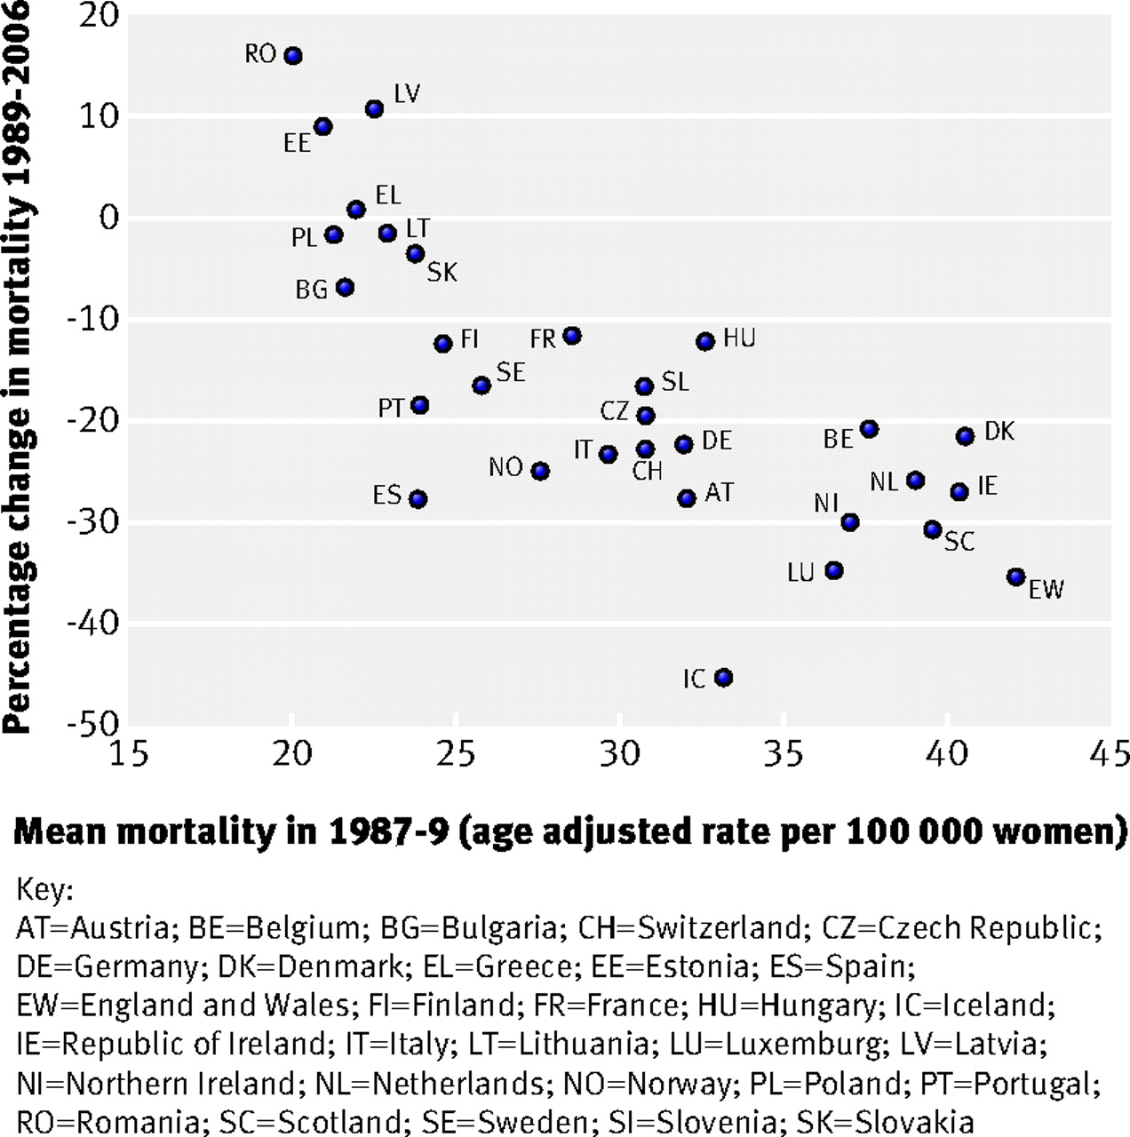
Autier P, Boniol M, LaVecchia C, et al.. BMJ. 2010

Slide 10
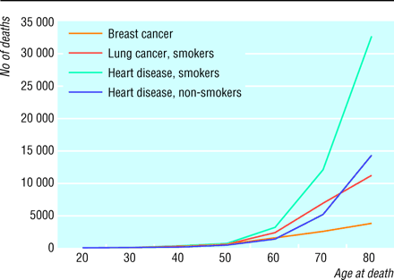

Slide 11
85%-90% 5-year survival
75%-80% 10-year survival
Autier P, Boniol M, LaVecchia C, et al.. BMJ. 2010

Slide 12
Most patients diagnosed today and treated for breast cancer, will die of something other than breast cancer

Slide 13
Evolution of breast cancer surgery

Slide 14
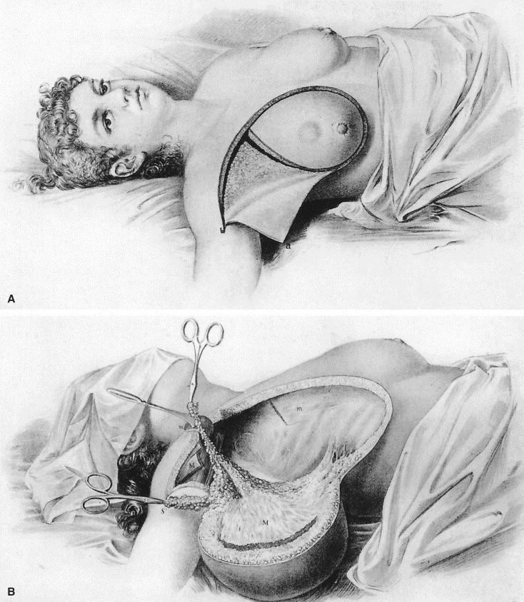

Slide 15
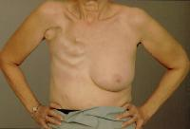
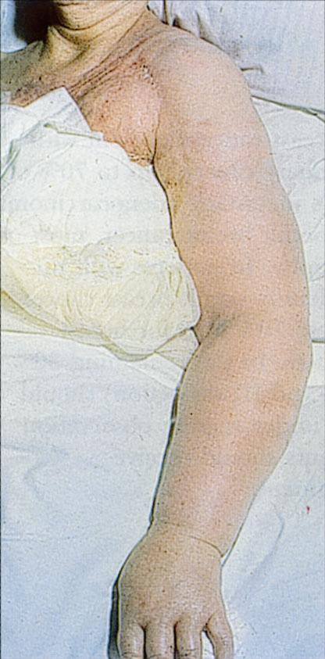

Slide 16
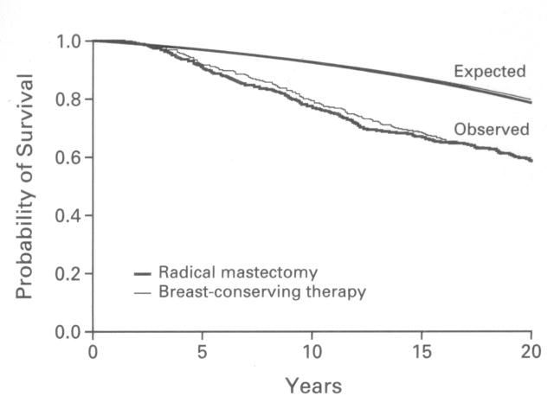
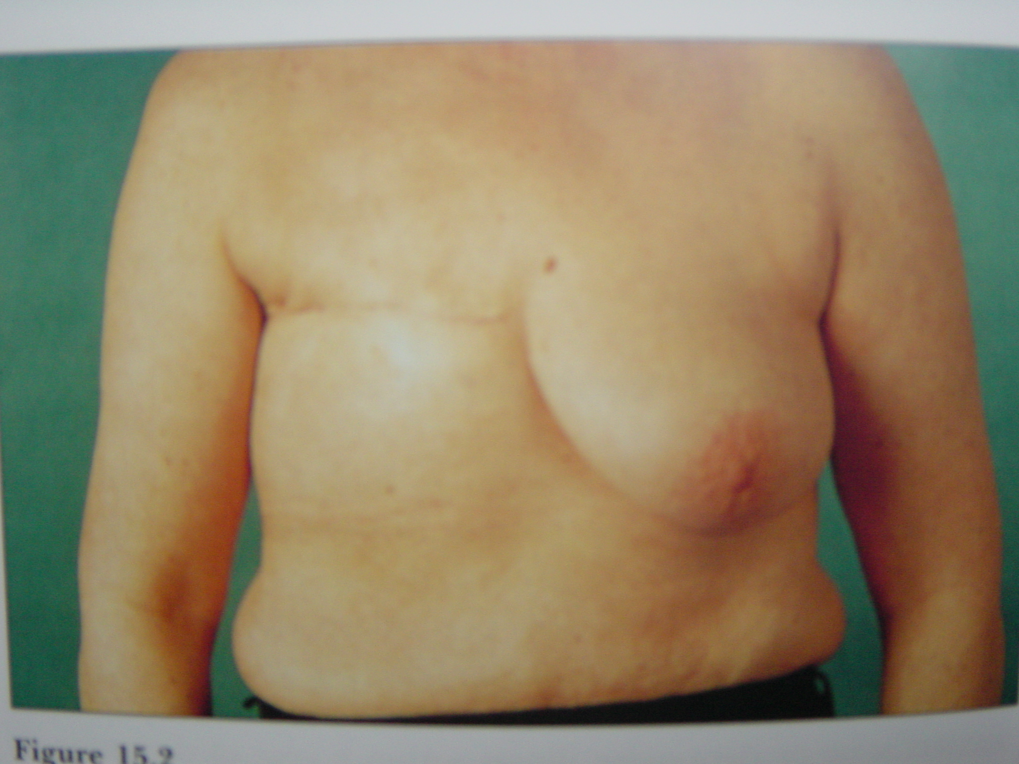
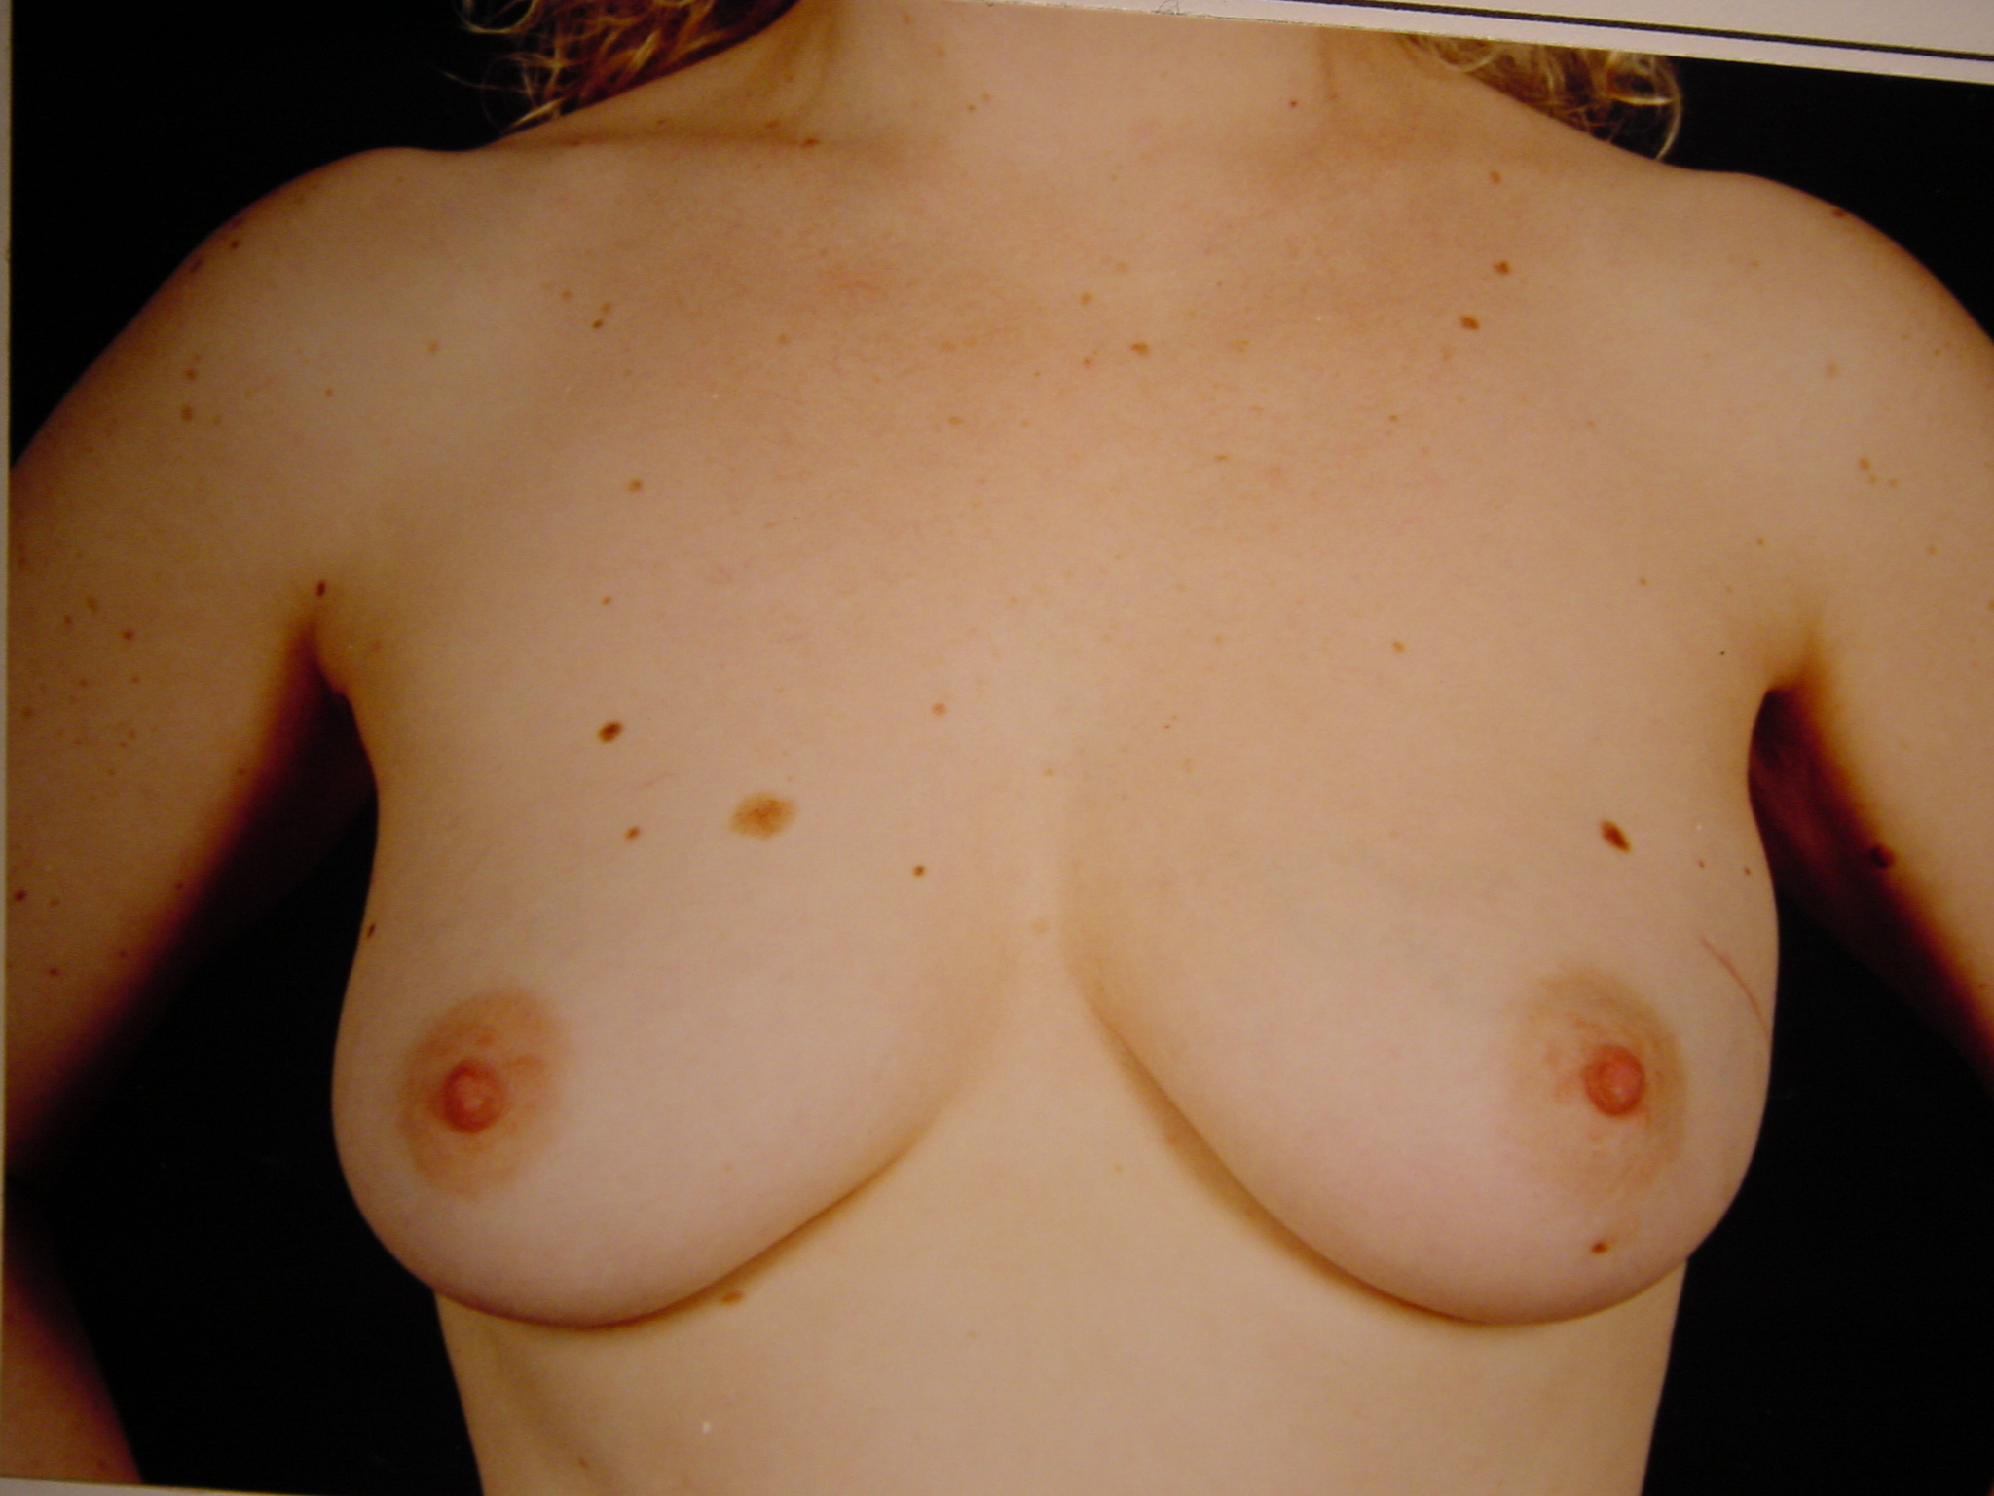
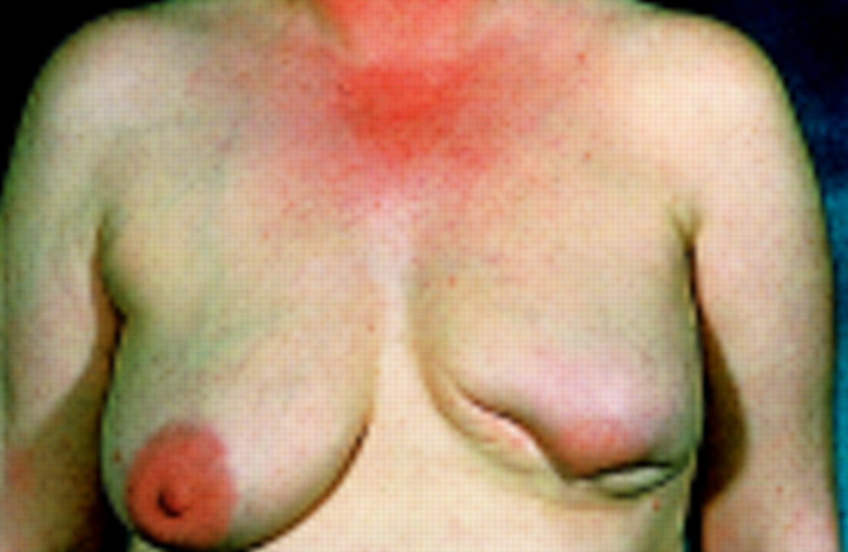
Mastectomy vs. Quadrantectomy + Rx
Veronesi U, et al. N Engl J Med 1981, 305, 6-11.
Notes:
Surgery to the breast has undergone significant changes within the last 30 years.
Until the 1960´s the operation of choice was radical mastectomy.
In the 1970´s and 1980´s several big trials worldwide demonstrated that breast-conserving surgery in the form of a wide local excision followed by breast radiotherapy was equivalent to mastectomy in terms of overall survival and local recurrence rate.
The surgical options that we offer newly diagnosed breast cancer patients today is based on two major randomized trial with a long-term survival results
The first one, with a first follow-up published in 1981 showed that for small tumours, the survival of women treated with quadrantectomies and radiotherapy was equal to if they were treated with mastectomy. Quadrantectomy implies that a quarter of the breast was removed and often these women have breast deformities. On longer term follow-up and most recently a 20 year follow-up confirmed these early findings

Slide 17
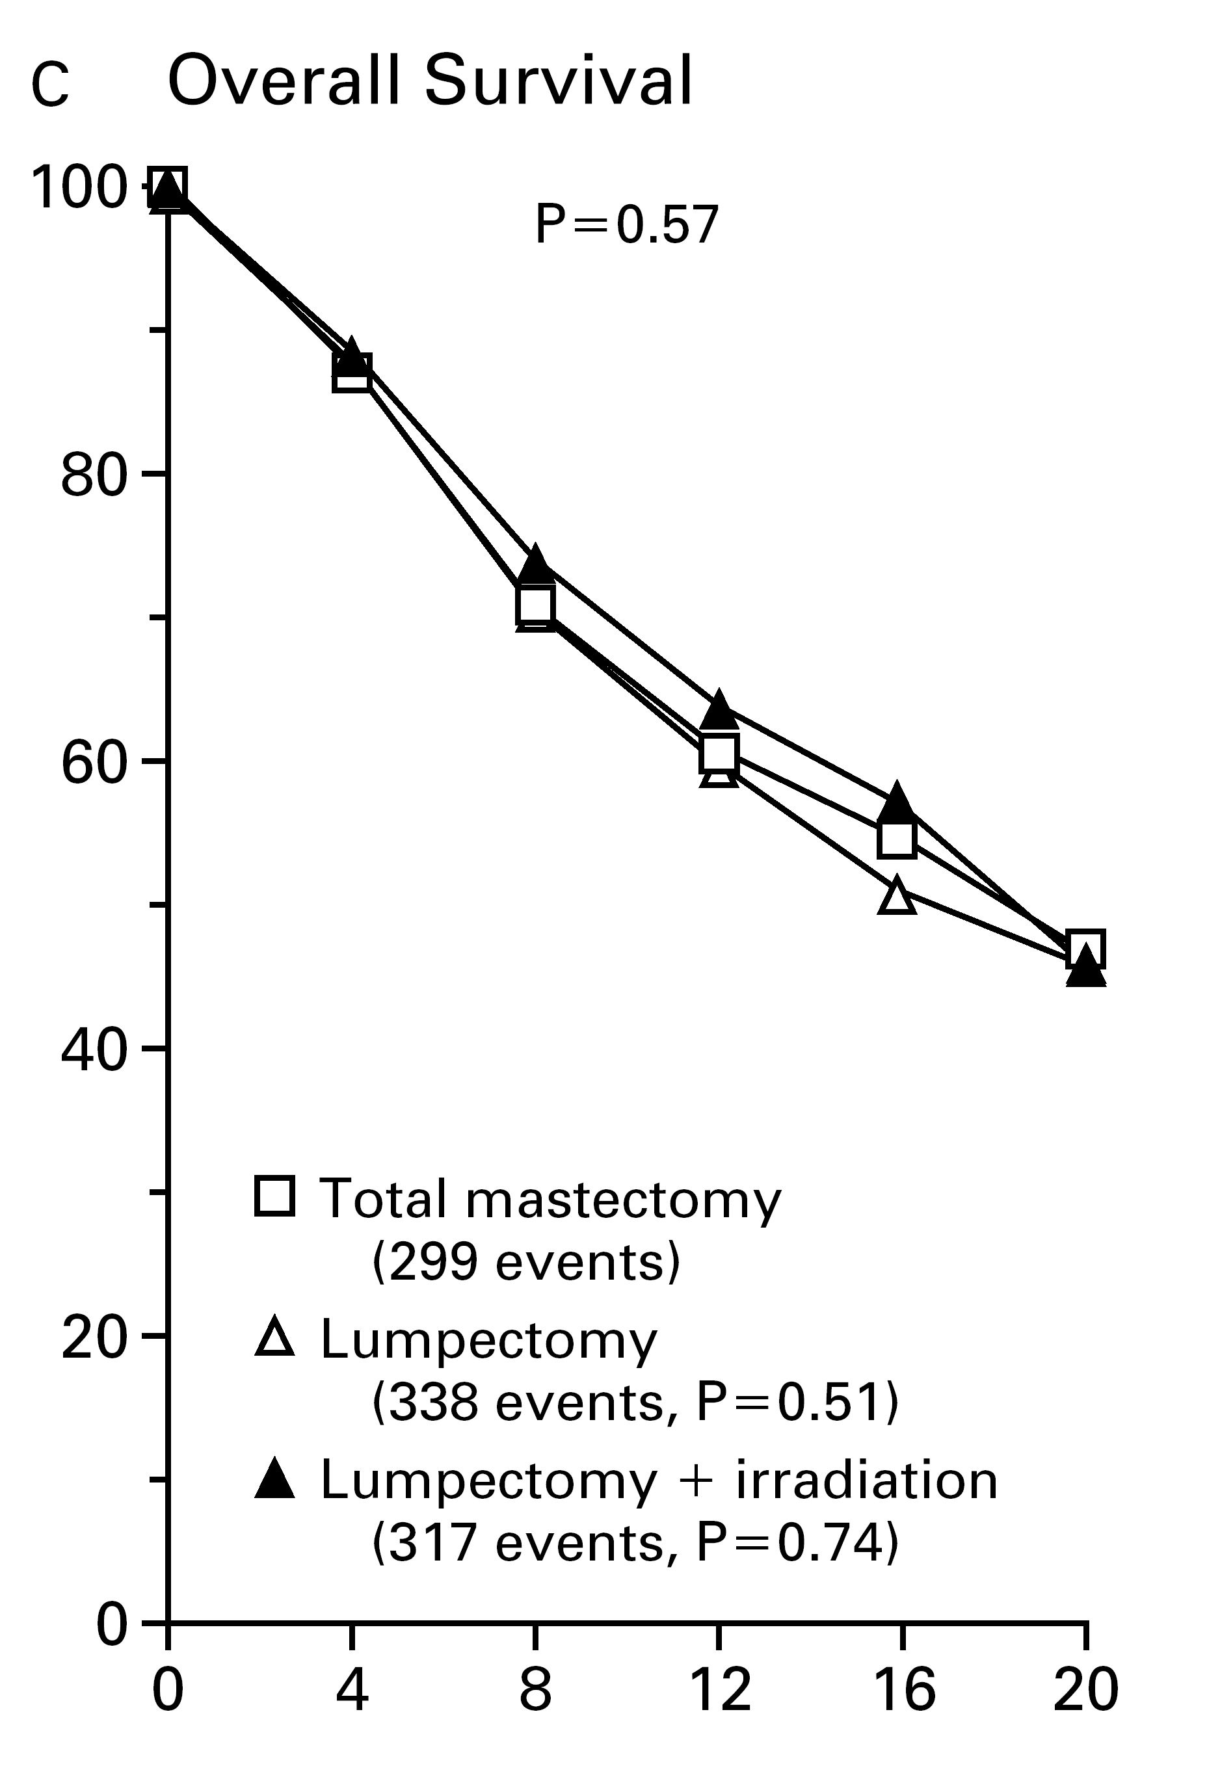
Mastectomy vs. Lumpectomy + Rx
Fisher B, et al. N Engl J Med 1985, 312, 665-673
Notes:
A further randomized trial by Fisher, where now a lumpectomy, that is only the tumour with a small rim of normal tissue, was excised, showed for tumours up to 4 cm in size, was associated with an equal survival to mastectomy and this, as in the Veronesi trial, was confirmed on 20 year follow-up.
This type of breast conserving surgery emphasized the point that there was no need to take out more tissue than was needed to obtain free margins. This way the risk of breast deformities were minimized.

Slide 18
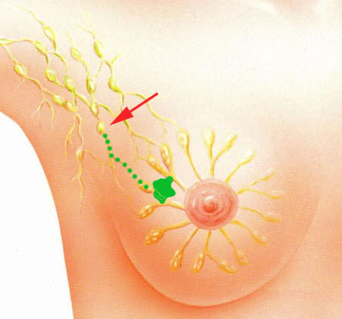
Sentinel lymph nodes

Slide 19


Slide 20

How can we
improve survival?
Quality of life
of survivors?
Notes:
Completely irrespective of treatment the qol of survivals becomes important

Slide 21

Quality of life
What are the effects of breast cancer treatment on quality of life issues?
Is quality of life equally as important as survival?

Slide 22
What is quality of life?
“An individuals appraisal of and satisfaction with their current level of functioning as compared to what they percieve to be ideal”
Cella and Tusky 1990
Notes:
Þá vitum við að brjóstamissir getur haft djúpstæð áhrif á sumar konurnar bæði andlega og félagslega
Á sama hátt líta aðrar konur á þennan atburð sem tækifæri til að endurskoða sitt líf og takast á við framtíðina með opnum örmum.
Það getur verið vandasamt þegar maður stendur frammi fyrir konu og hefur nýverið sagt henni að hún er með brjóstakrabbamein, í hvaða flokki hún er.
Það er krefjandi að ná þeim djúpum tengslum við konur til þess að skilja þess vilja einstakra kvenna og eru því þessir sérhæfðu hjúkrunarfræðingar mjög mikilvægur partur af þessari ákvörðunartöku

Slide 23
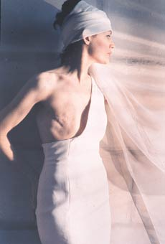
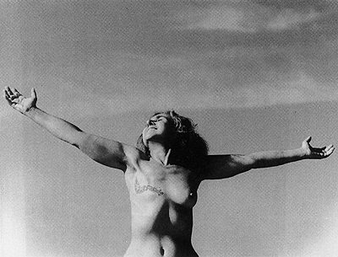
Notes:
Á meðan sumar konur eiga við mörg andleg og félagsleg vandamál að stríða í kjölfar brjóstabrottnáms eru aðrar konur sem takast á við framtíðina og lífið með opnum örmum endurskoða líf sitt og vegur brjóstabrottnám lítið þegar allt annað er tekið til greina
Það getur verið vandasamt þegar maður stendur frammi fyrir konu og hefur nýverið sagt henni að hún er með brjóstakrabbamein, í hvaða flokki hún er.
Það er krefjandi að ná þeim djúpum tengslum við konur til þess að skilja þess vilja einstakra kvenna og eru því þessir sérhæfðu hjúkrunarfræðingar mjög mikilvægur partur af þessari ákvörðunartöku

Slide 24

“Life after Mastectomy”
Notes:
Ef við tökum til dæmis konu sem þarf að fara í brjóstabrottnám
H’un brosir en hvaða áhrif hefur mastektómían raunverulegt haft á hennar líf og lífsgæði
Það er athyglisvert að skoða skilgreininguna á lífsgæði
Þar er lagt áherslu á mat einstaklingsins og eina leiðin til þess að komast að þessu er að tala við konuna

Slide 25
Sexual
function
Psychosocial
function
Cosmetic outcome
Body
Image
Notes:
Cosmesis encompesses
And surely cosmetic issues in breast cancer surgery and its relationship with quality of life issues is certainly not a new thing. If you look at the basic outcome measure of the mastectomy vs. breast conservation trials both in the USA and Europe, it was percieved that breast conservation would provide better cosmetic outcomes when compared to mastectomy. Although none of these trials in fact assessed cosmesis.

Slide 26
Modern breast surgery
Local Control
Cosmesis/Maintain
quality of life
Notes:
Optimizing local control by achieving low rates of margin involvement and local recurrence, whilst at the same time achieving low rates of cosmetic failure, at the same time we want to achieve low rates of morbidity, as we do not want to put our patients through unecessarily big surgery to achieve optimal outcomes on both parts
Optimizing the two important outcomes of breast conservation, that is local control by big wide local excisions and decrease risk of margin involvement and decreasing risk of cosmetic failure

Slide 27
…...Is specialist breast surgery and involves training surgeons to become oncoplastic breast surgeons

Slide 28
Specialisation in breast surgery = Improved patient outcome
Author | Cases/year | Results
Roohan et al, 1998 | >150 vs.<10 | 60% reduction in mortality
Skinner et al, 2003 | >125 vs. <35 | 23% reduction in mortality
Mikeljevic et al, 2003 | >50 vs. <10 | 27% reduction in mortality
Notes:
Í sérhæfðum brjóstaeiningum þar sem fjöldi aðgerða pr. Kírúrg er hærri er kírúrgíska meðferðin markvissari, staðbundnar og regional endurkomutíðnin lægri og þar með horfurnar betri.

Slide 29
“Specialist breast surgery is the basis for good outcomes”
  Better survival
  More likely to be offered breast conservation than mastectomy
  Recurrenc rates lower
  Immiediate breast reconstruction more likely
  Improved quality of life?
“Consensus Conference on Breast Conservation”. Cancer 2006

Slide 30
Oncoplastic breast surgery
Breast conservation
Immediate total breast
reconstruction
Therapeutic
Mammoplasty
(Volume displacement)
LD-minifl/LICAP
(Volume replacement)
Implants
Flaps
Notes:
So the concept of oncoplastic breast surgery was used for techniques that improve outcomes in breast conservation with volume replacement or volume displacement and immediate total breast reconstruction.
More recently the term has been expanded to incorporate techniques to improve outcomes of traditional breast cancer surgery, risk reducing surgery and delayed total breast reconstruction

Slide 31
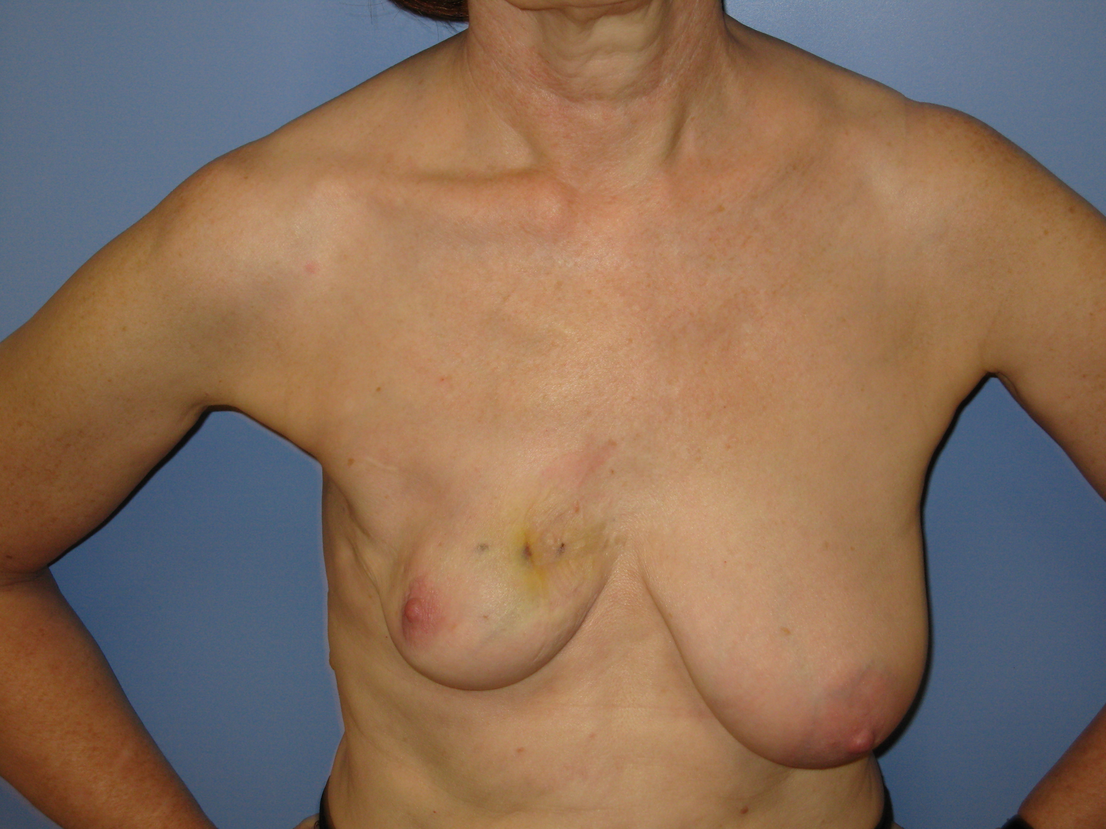
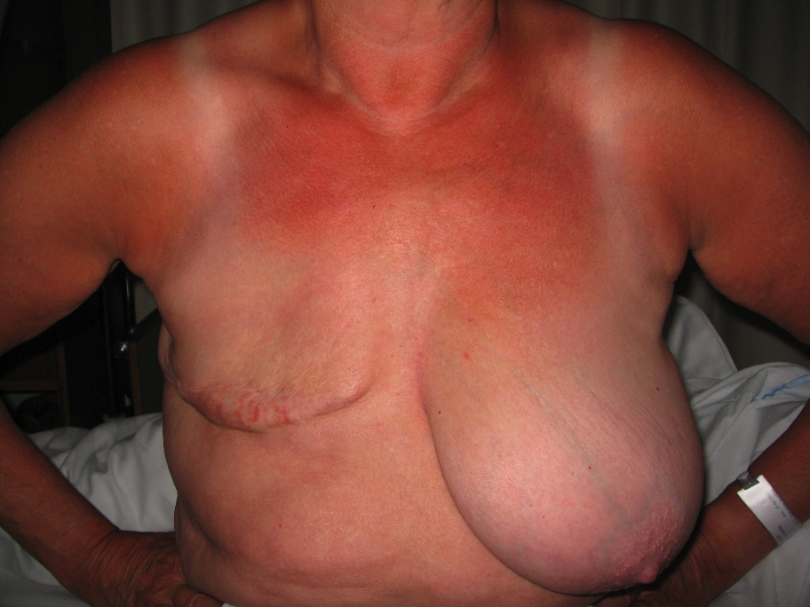
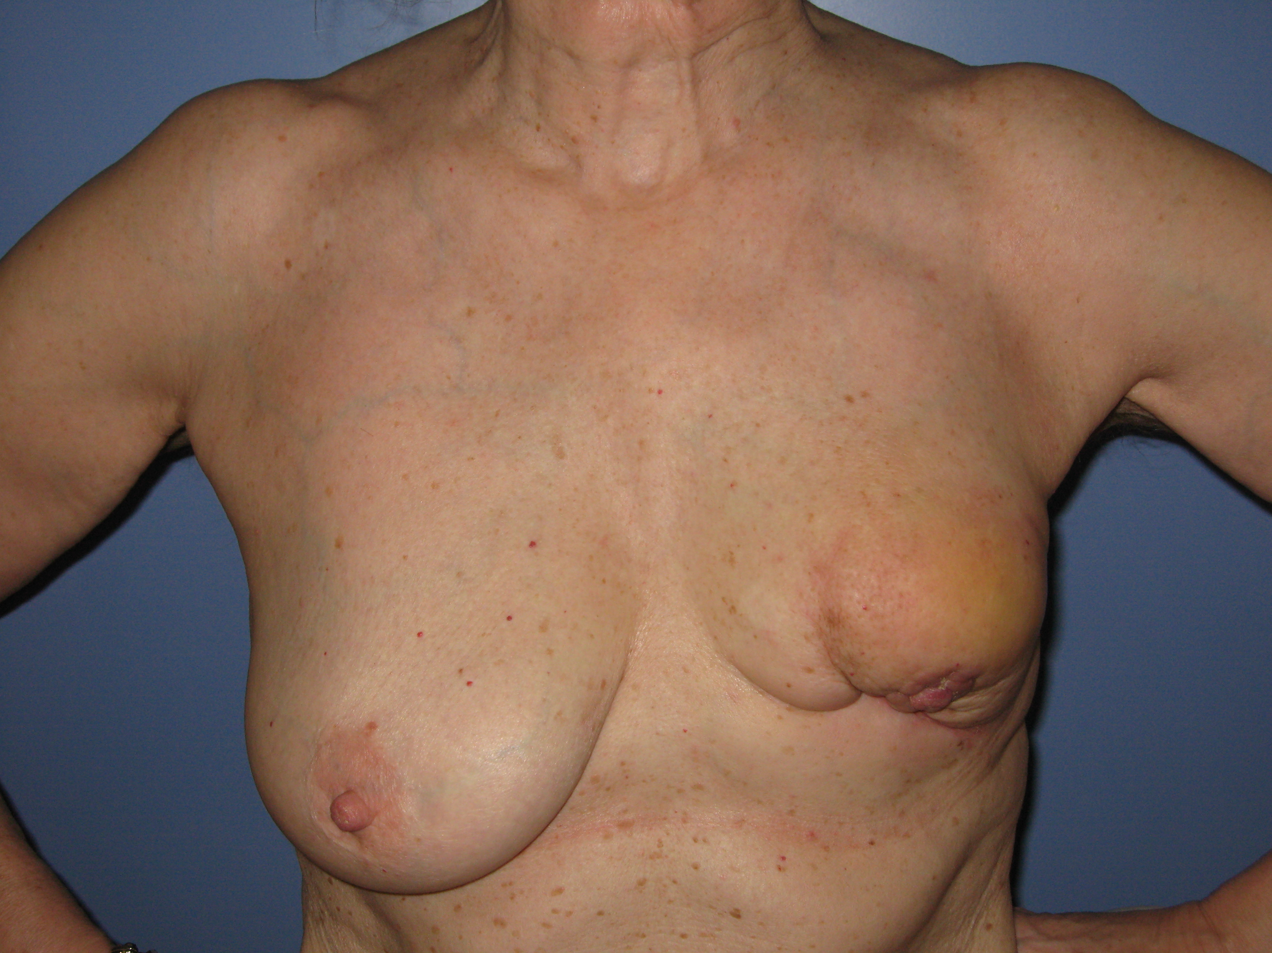

Slide 32
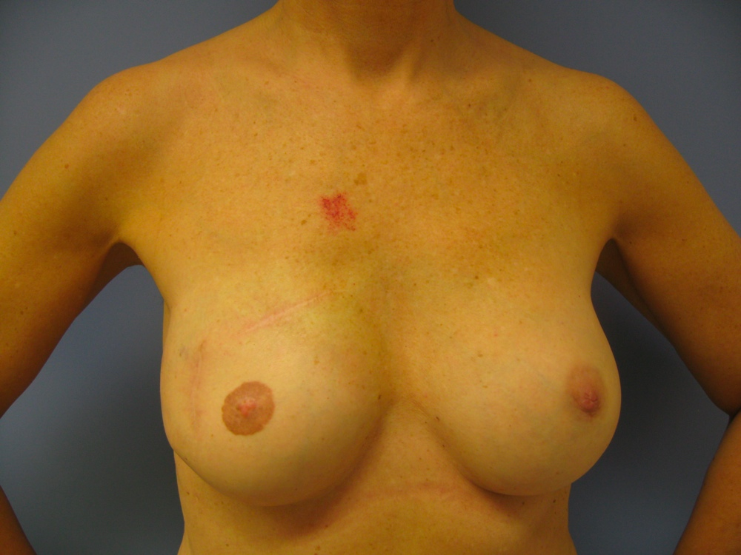
Notes:
We believe that we are, with this type of surgery , having a major impact on the quality of life of our patients
In the hope that this will of course improve the quality of life of our patients

Slide 33

Oncoplastic breast surgery offers CHOICE

Slide 34

“If you only have hammer you see a lot of things that need hammering”
Jonathan Swift
Notes:
Er það alveg ljóst að ef við bjóðum bara upp á einfaldan fleygskurð eða brottnám, þá munu lífsgæði margra kvenna vera verulega skert, þó þær séu læknaðar af sínum sjúkdómi

Slide 36
Oncoplastic operations and breast conservation

Slide 37
Using breast reduction techniques

Slide 38
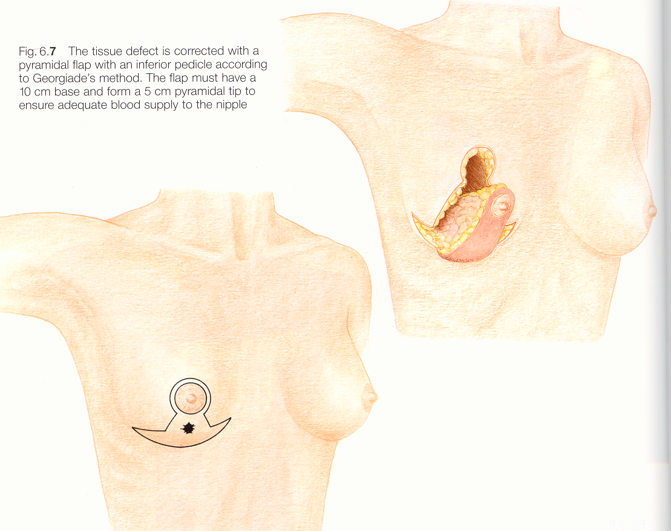
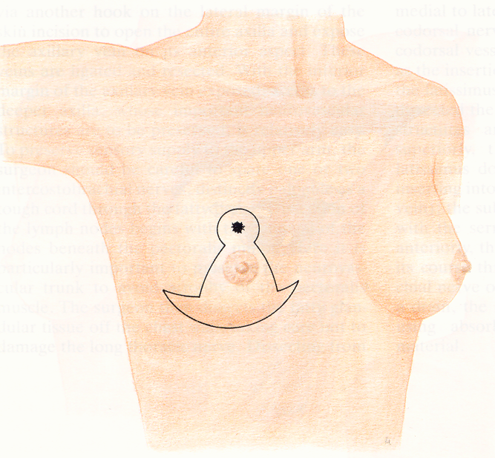

Slide 39
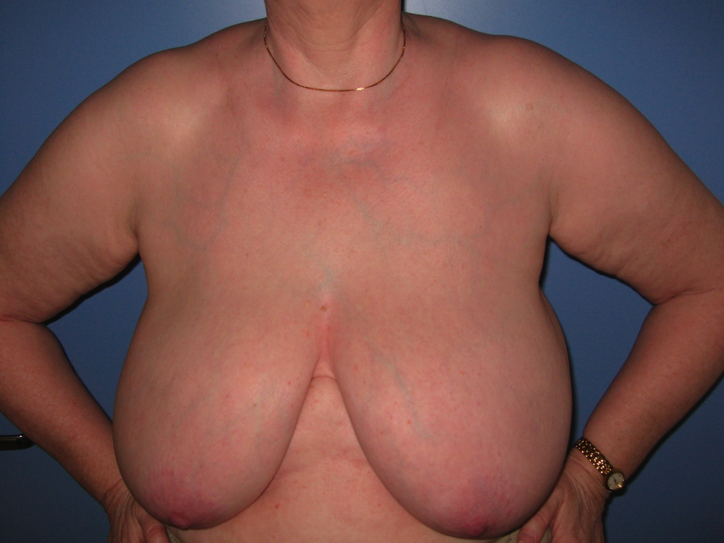
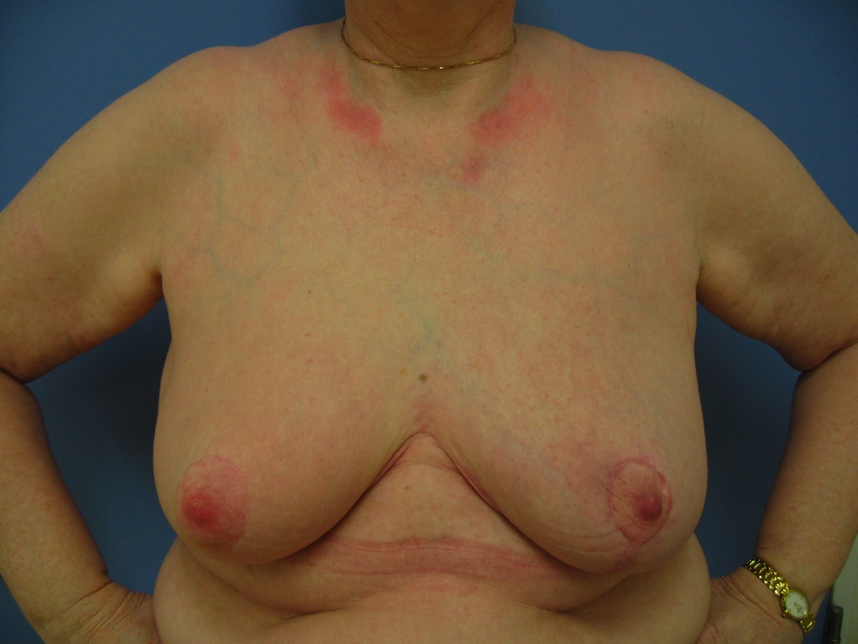
Notes:
Tvíþættur tilgangur: Taka cancerinn og minnka brjóst,ekki af því bara, heldur geislameðferð auðveldari

Slide 40
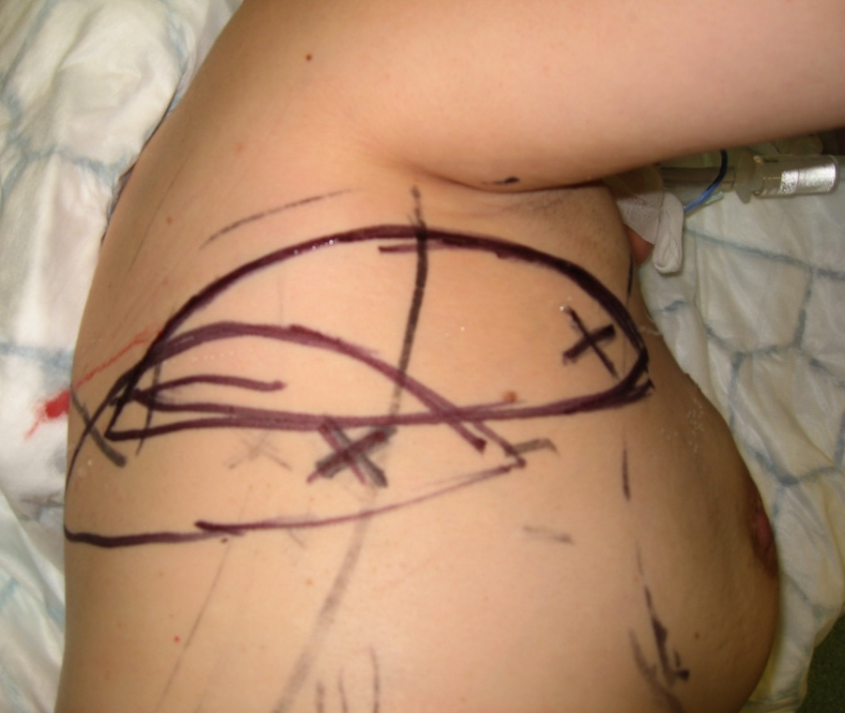
Using tissue elswhere to fill defects in breast
Li-CAP flap
T-DAP flap
LD Mini-flap

Slide 41
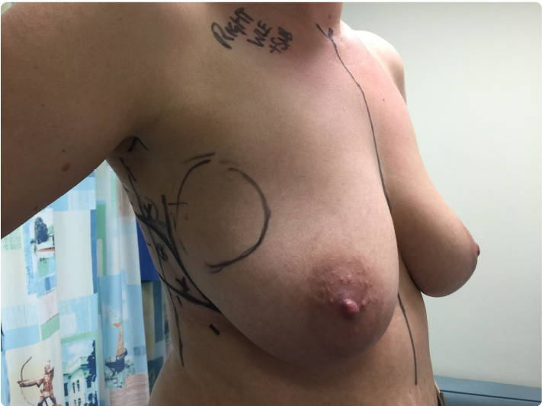
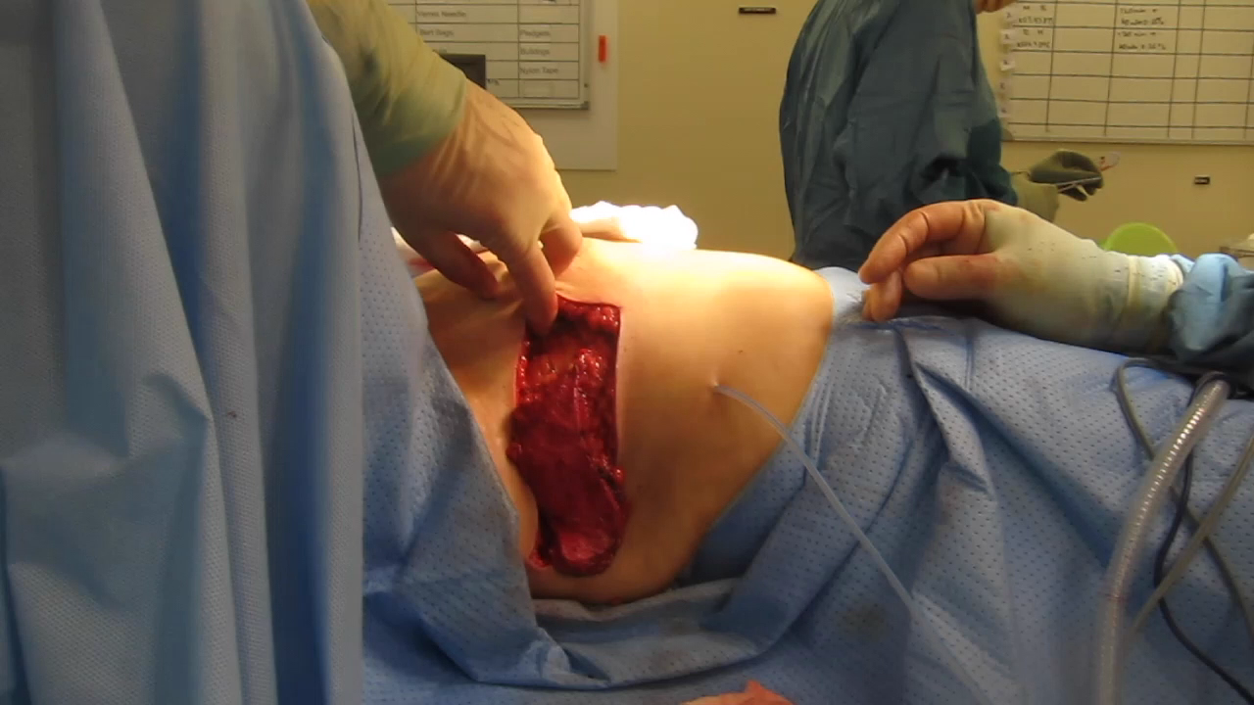
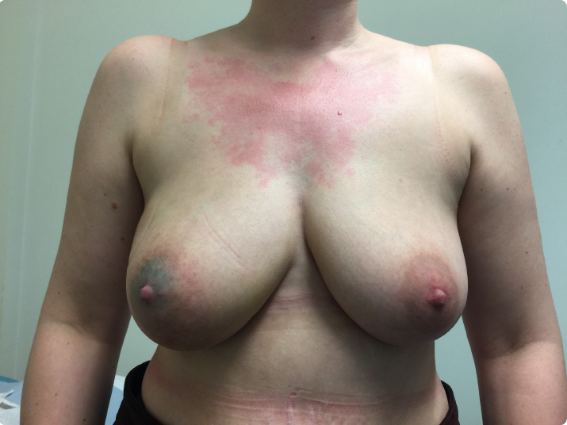

Slide 42
Whole breast reconstruction at same time as mastectomy

Slide 43
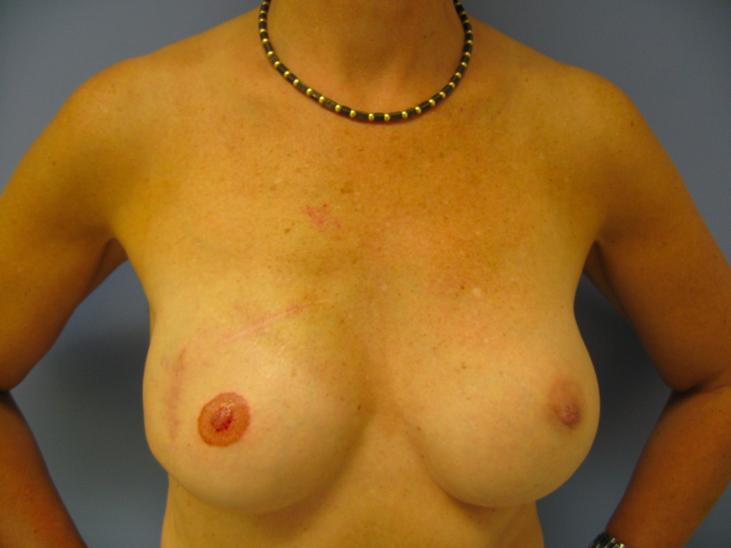
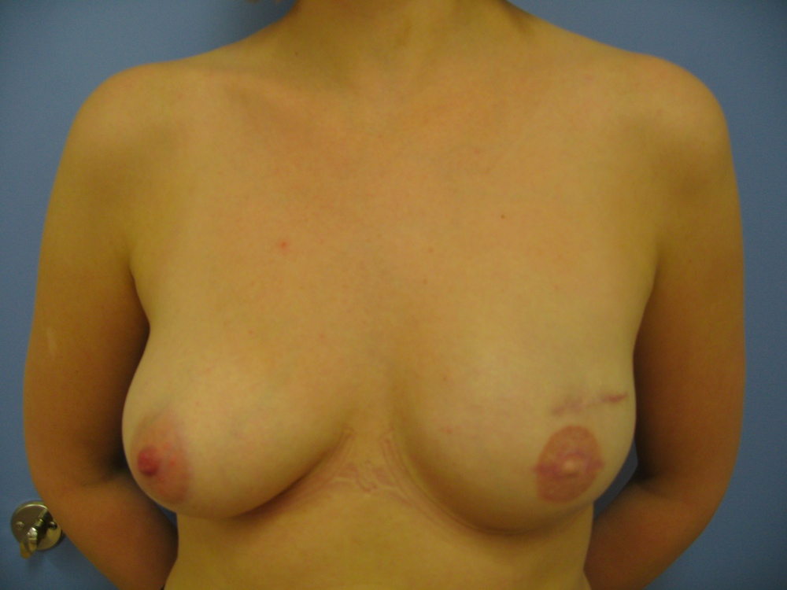
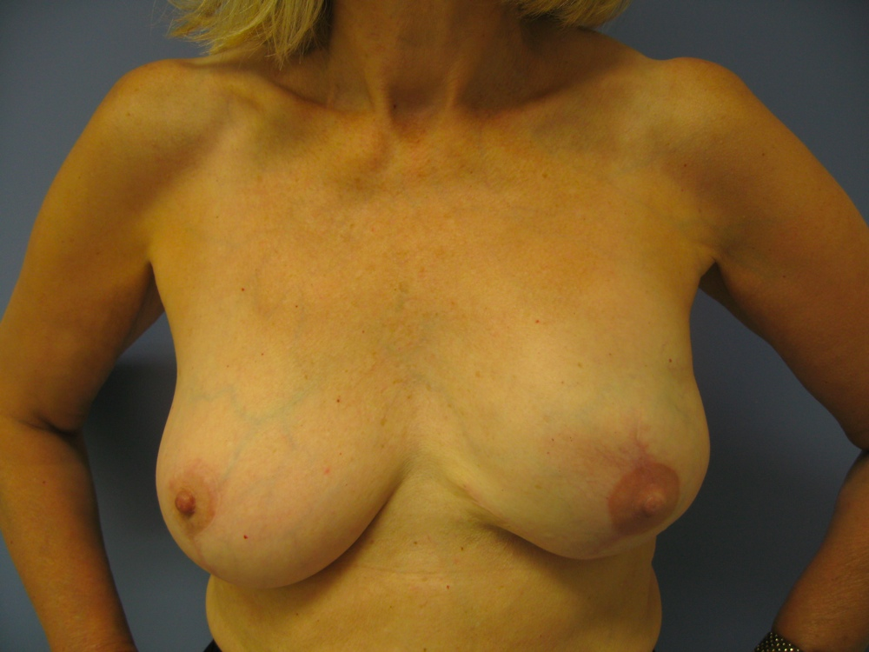


Slide 44
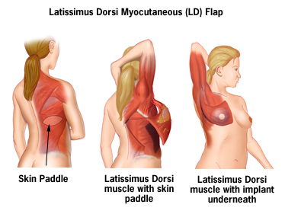
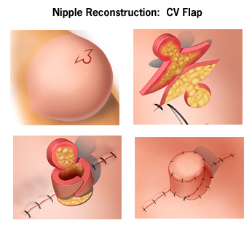
Using own tissue
Notes:
44

Slide 45
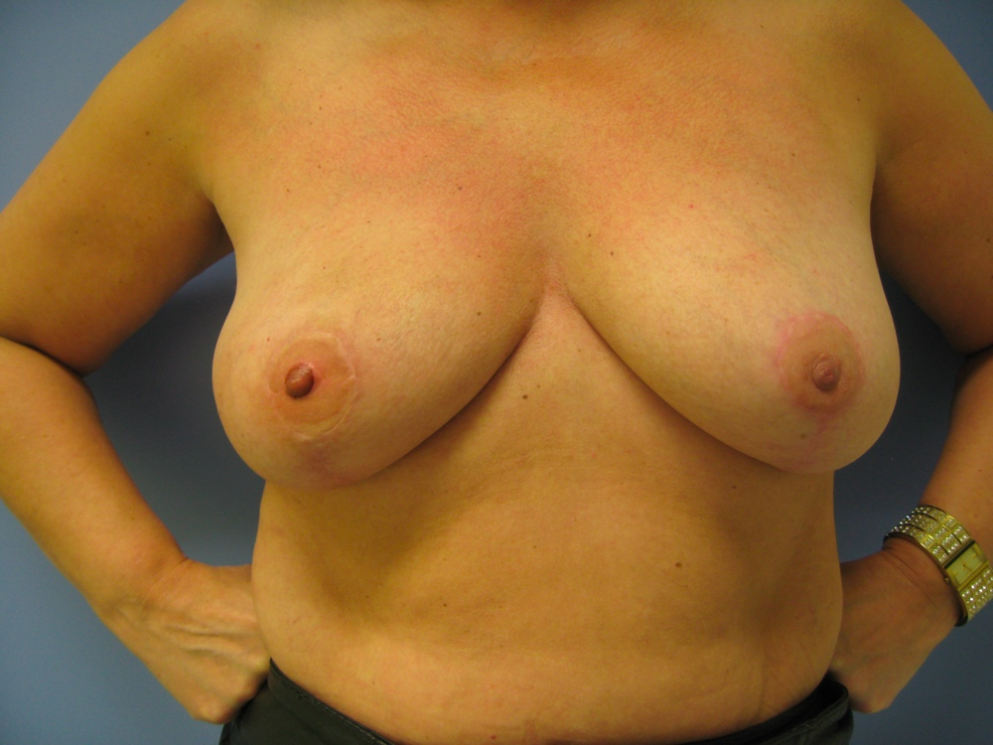
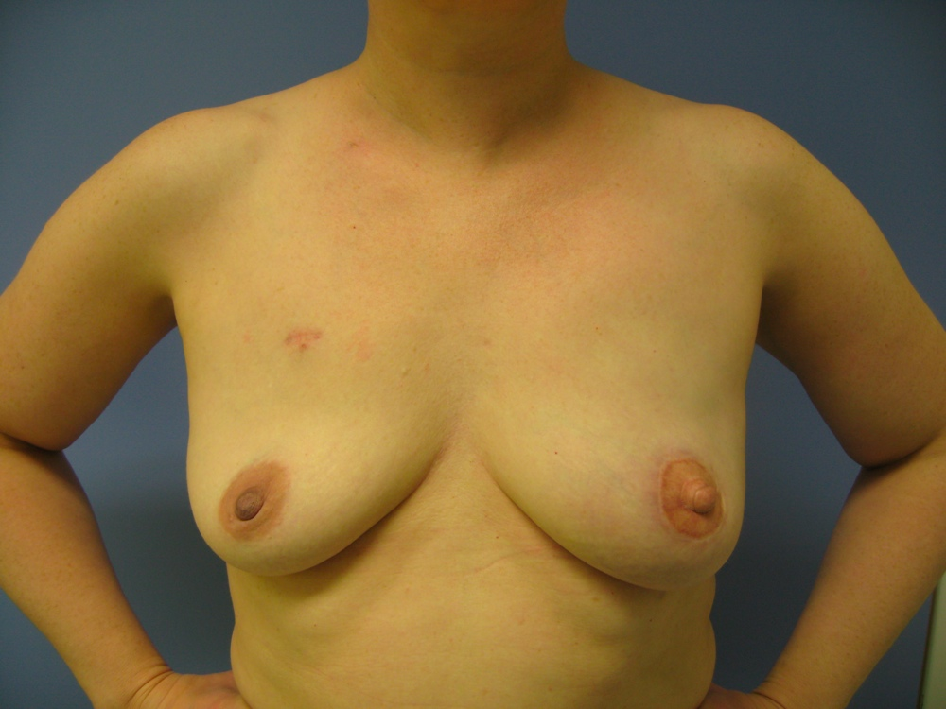
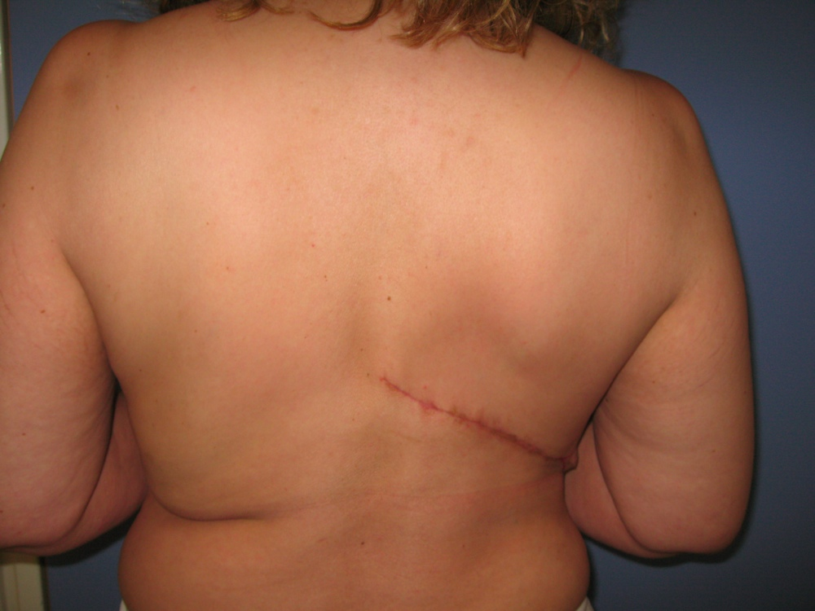

Slide 46
Preventing breast cancer
- Reducing risk of developing breast cancer

Slide 47
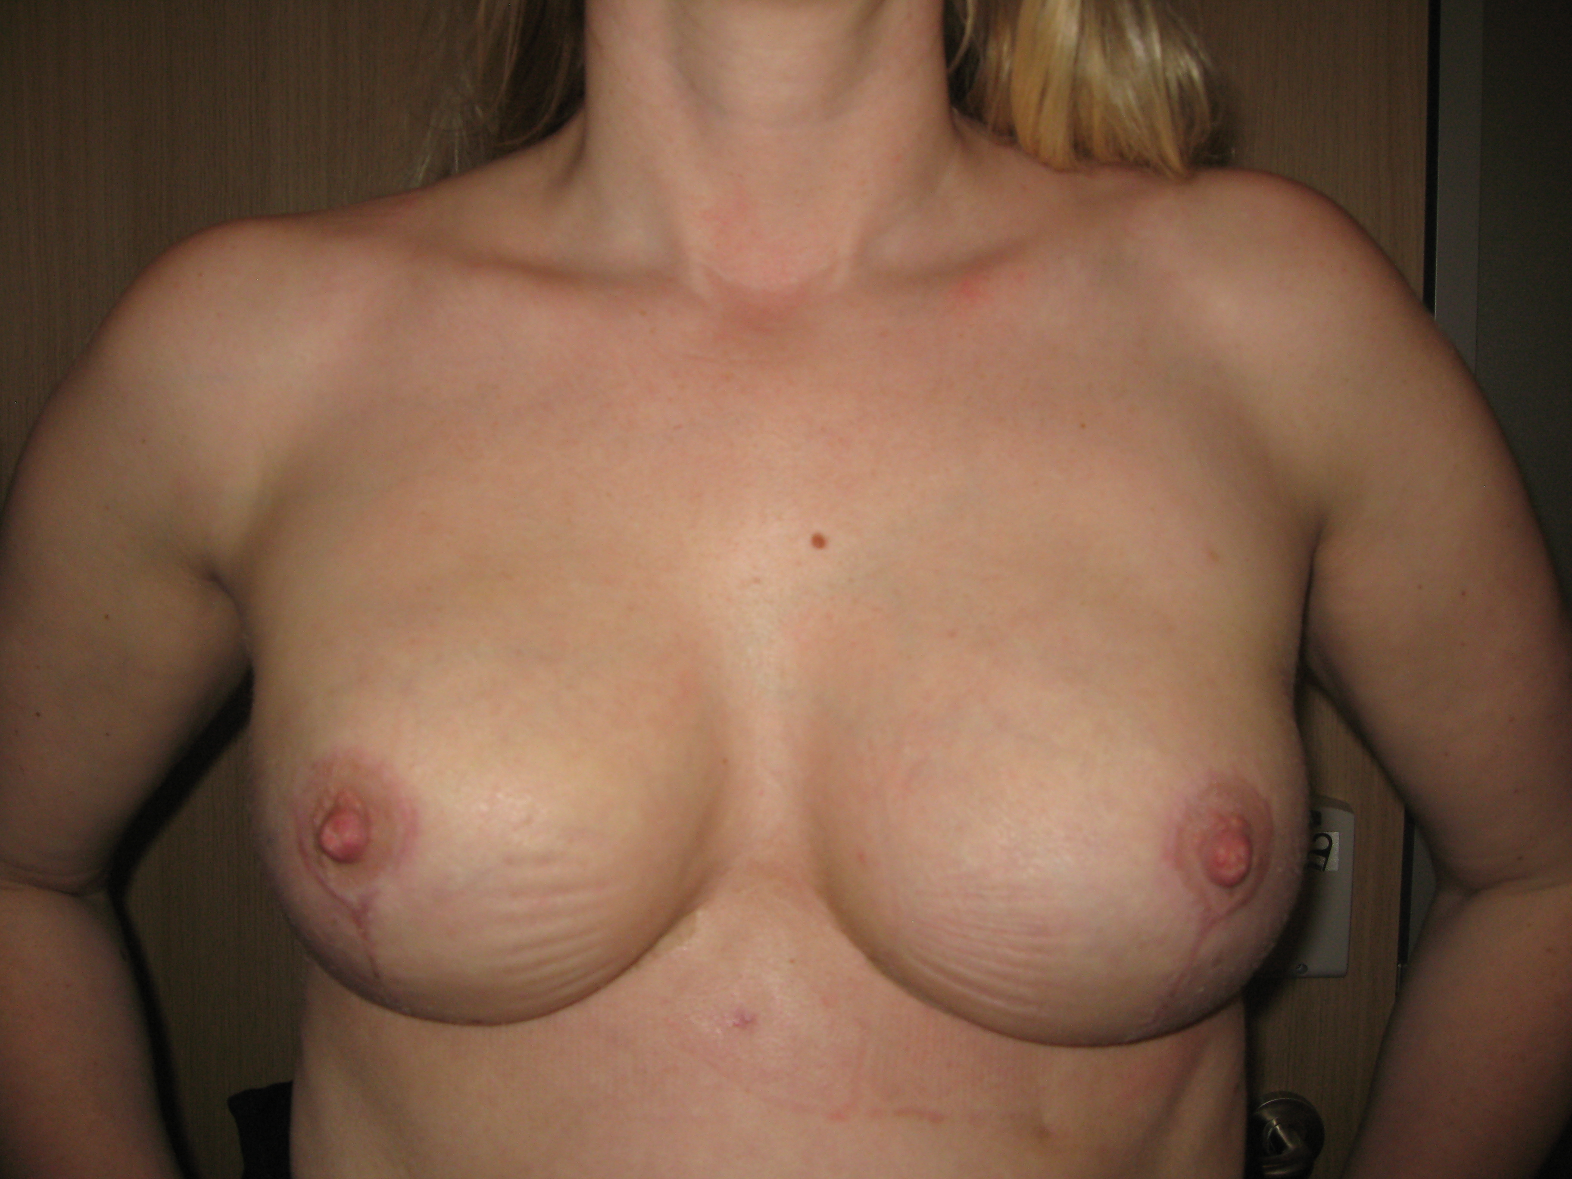
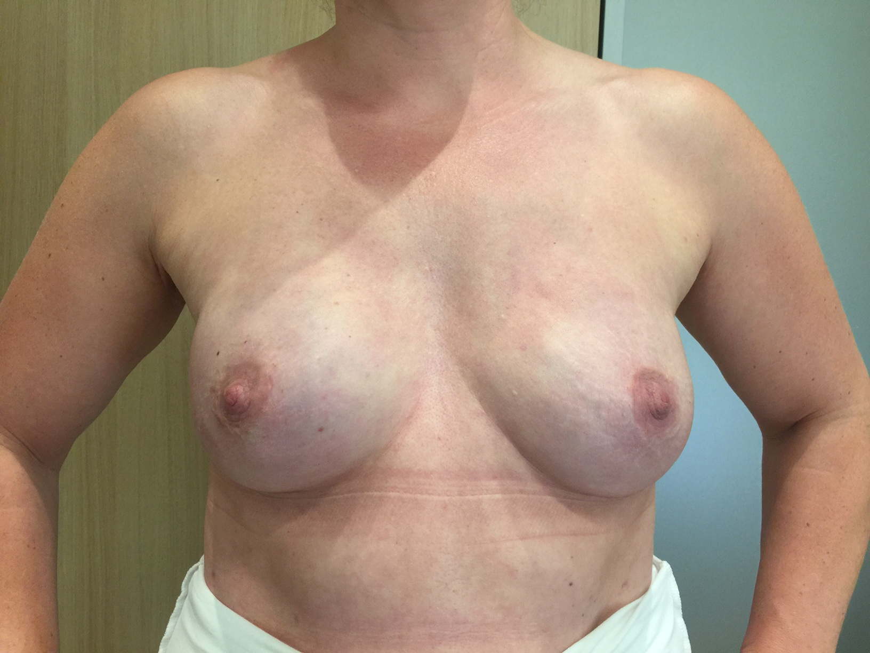
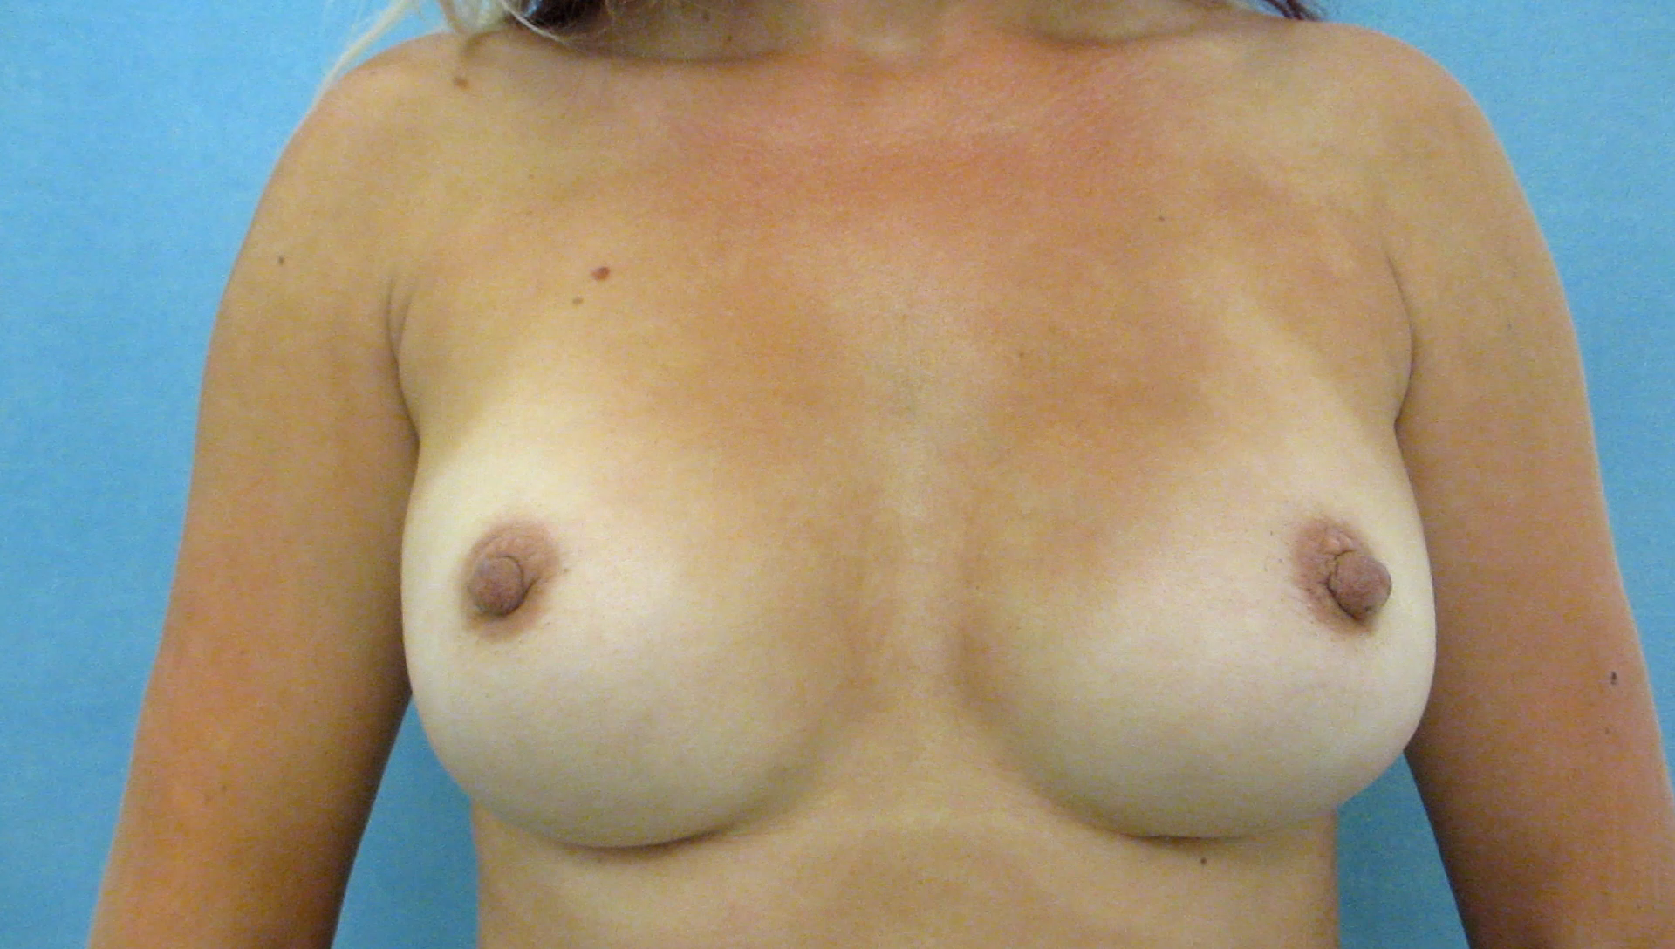
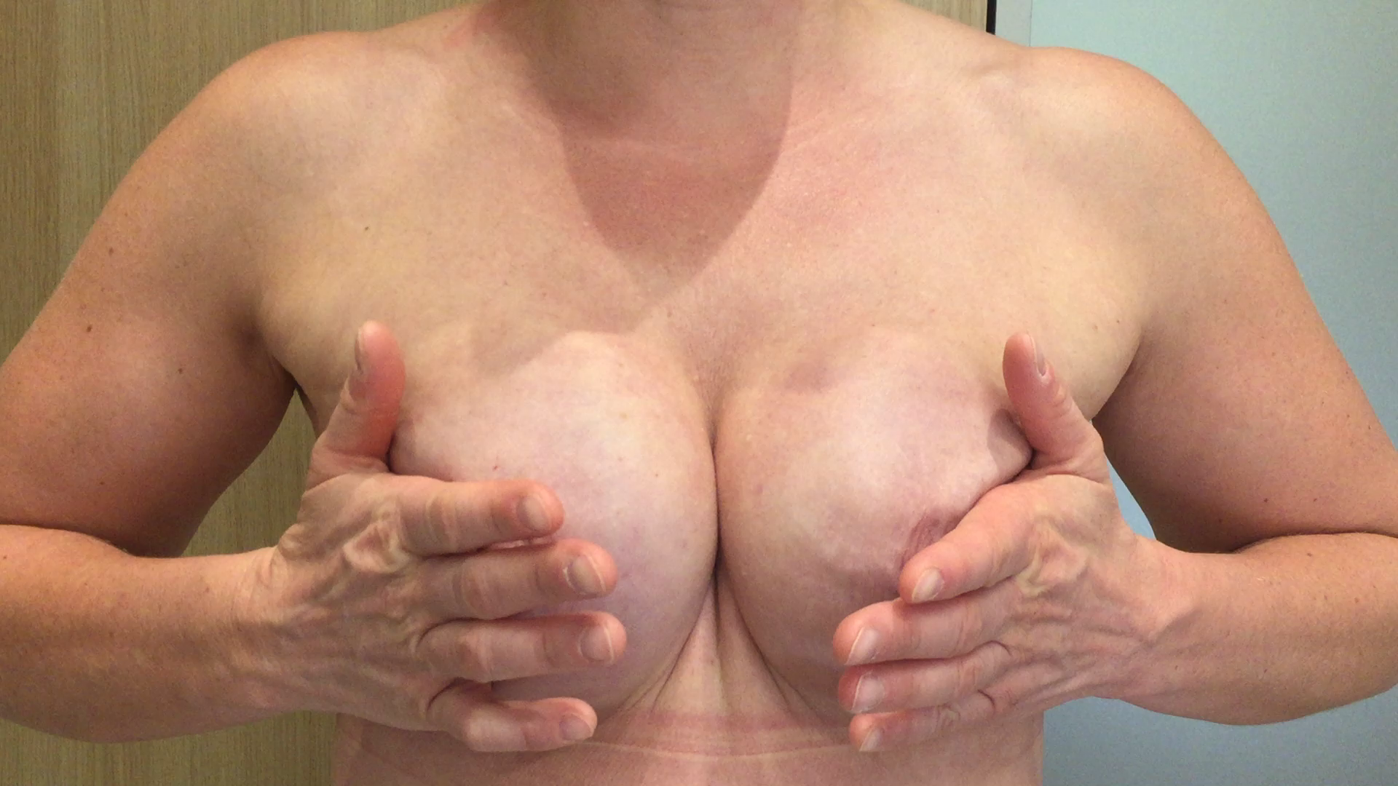

Slide 48
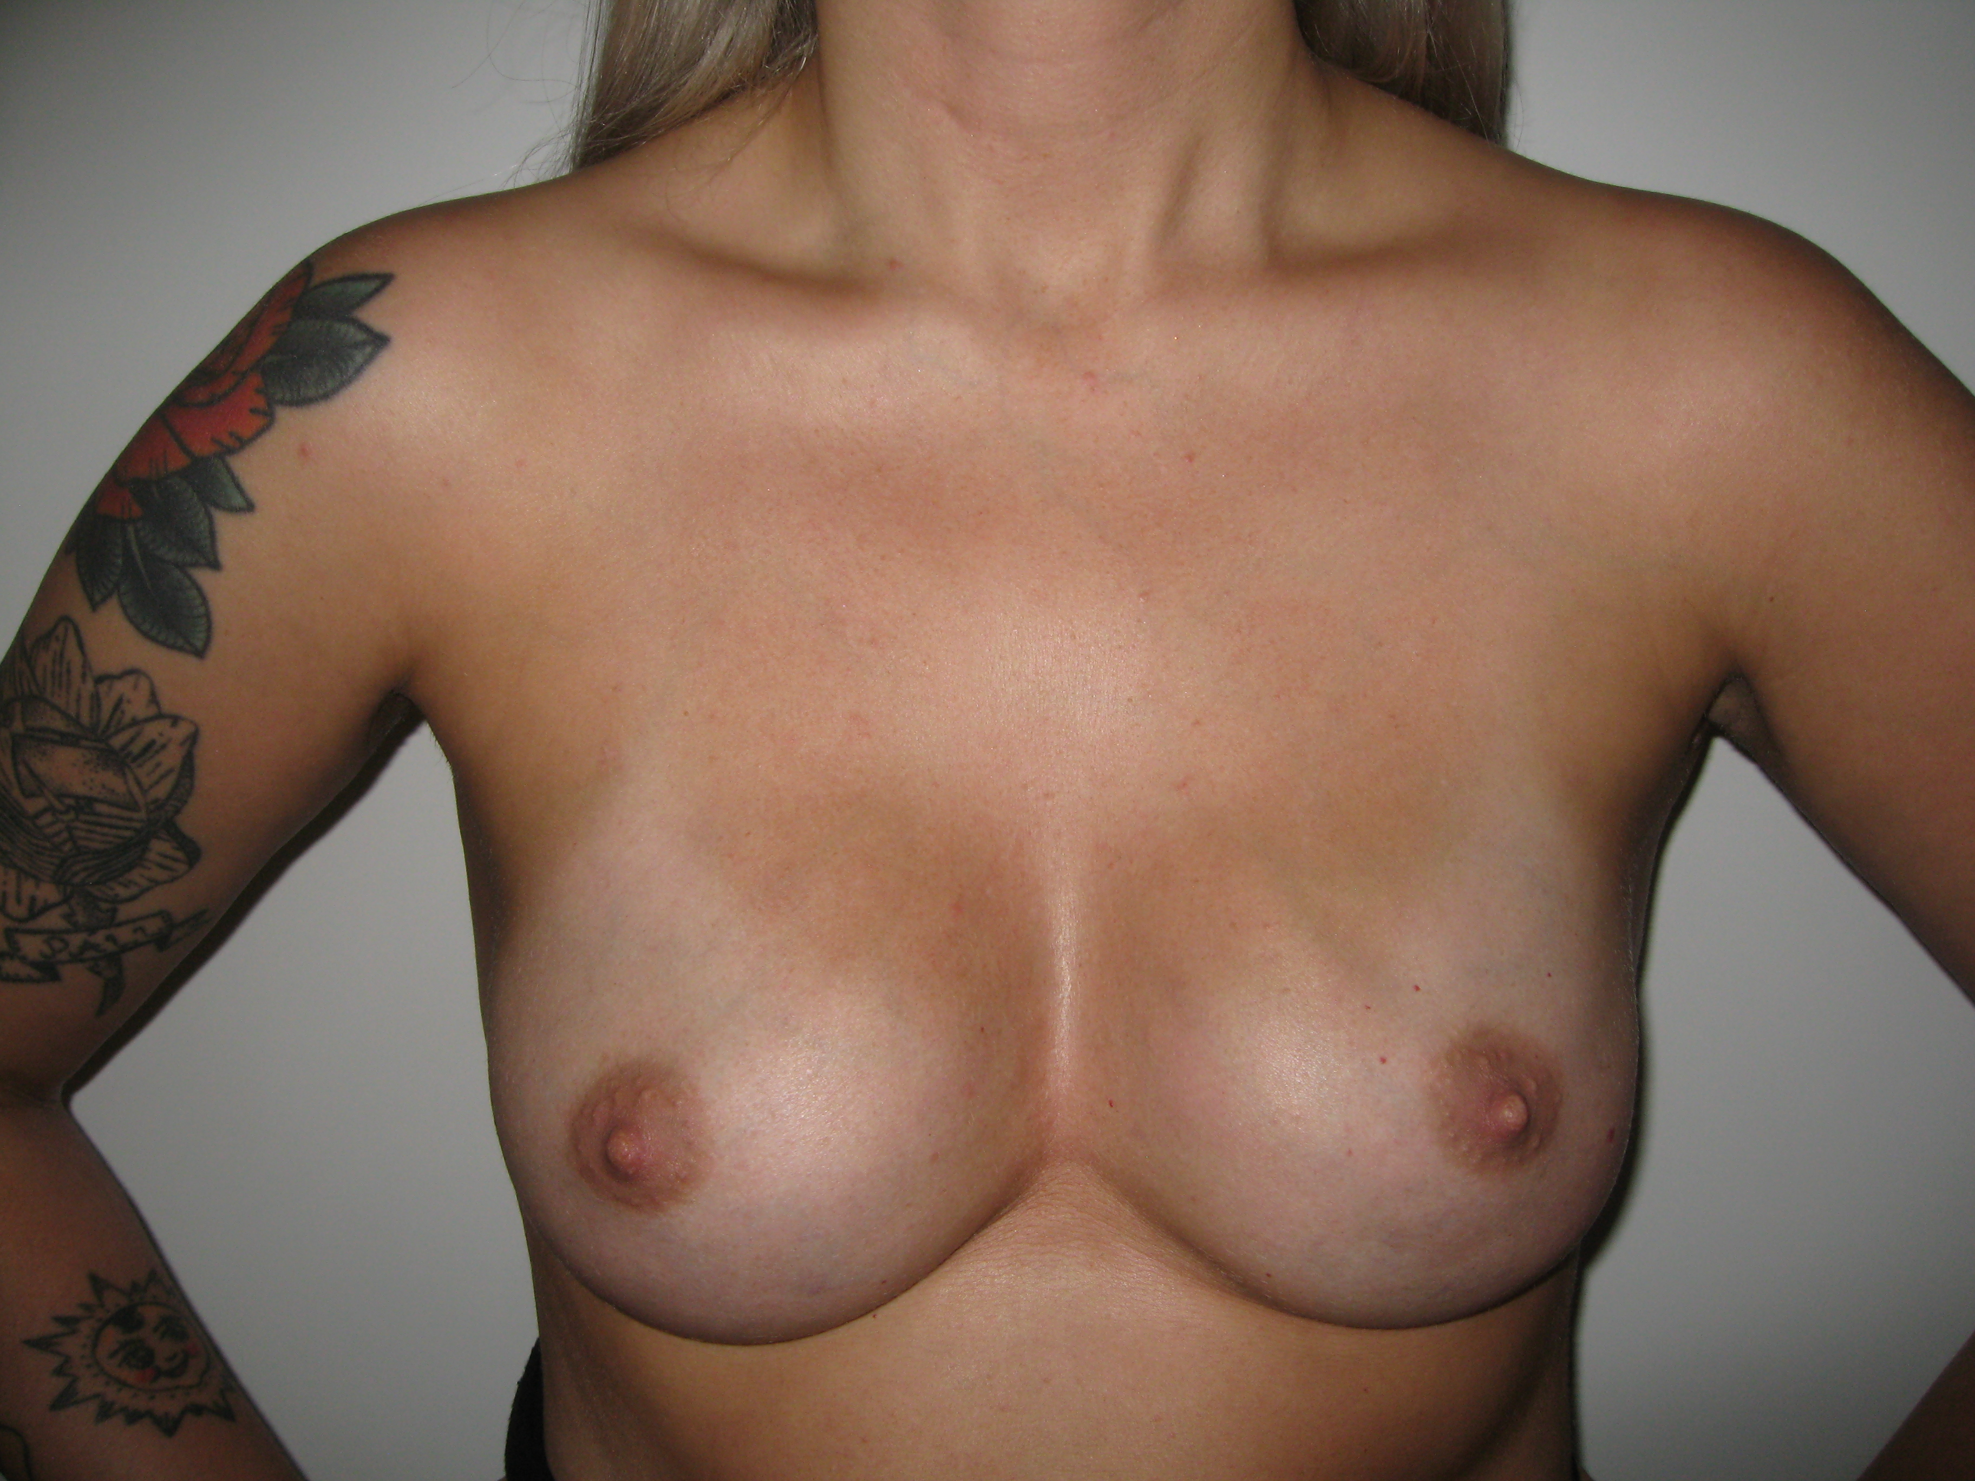


Slide 49



Slide 50

Oncoplastic breast surgery is NOT cosmetic surgery, it is reconstructive surgery
Notes:
Þó tæknilega svipaðar aðferðir, þá er hugmyndafræðin og drifkraftin á bak við það allt annar

Slide 51
Choice
surgeon/service
related factors
Cancer
related factors
Specialised breast
surgical service
Patient
Body habitus
Patient
Expectations/
Wishes
Information
Notes:
Offer and have choice
Cancer related factors – deliberately left out as I don´t believe they are of as much an issue as before.

Slide 52
Summary
Lots of advances have occurred in breast cancer surgery
Often possible to safely offer women breast conservation as opposed to mastectomy
Breast reconstruction performed in conjunction with breast conservation and mastectomy is increasingly being offered
    Oncoplastic Breast surgery
Oncoplastic breast surgery may significantly improve quality of life of many breast cancer survivors
Notes:
The relevant question now in our current climate of economic crisis is, will the hospital managers in our hospital allow the continuing evolution of breast surgery to continue????

Slide 53
Patient
“The system”
Notes:
And although the main goals of this cancer plan was to streamline and improve the efficiency of the patients pathways from diagnosis to treatment, spin-off issues from this plan was the assessment of quality and accessibility of various aspects of the service.
With regards to breast cancer surgery, an nationwide audit showed that in 1997 tol 1998, only 7% of patients treated with mastectomy had immediate total breast reconstruction and furthermore, there was a great variation in this percentage and accessibility for reconstruction, depending on where you lived in the country
Only about 5% of patients in the late 1990´s were offered immediate breast reconstruction

Slide 54
Summary
Many surgeons are training to become oncoplastic breast surgeons
This type of surgery needs to be more widely available/offered to breast cancer patients
Oncoplastic breast surgery offers women choice
Notes:
The relevant question now in our current climate of economic crisis is, will the hospital managers in our hospital allow the continuing evolution of breast surgery to continue????

Slide 55
It is European legislation that says that within EU, is the right of the patients to seek medical care over borders

Slide 56
If you are not offered choice, you should seek medical treatment, where you deem it to be best and you are given choice

Slide 57
This is your legal right and should be paid for by your own government

